Slide 1
Cadoxton Primary School
PROSPECTUS 2022-2023 prospectws
Learning and Growing Together, Being our Best Forever!

Slide 2
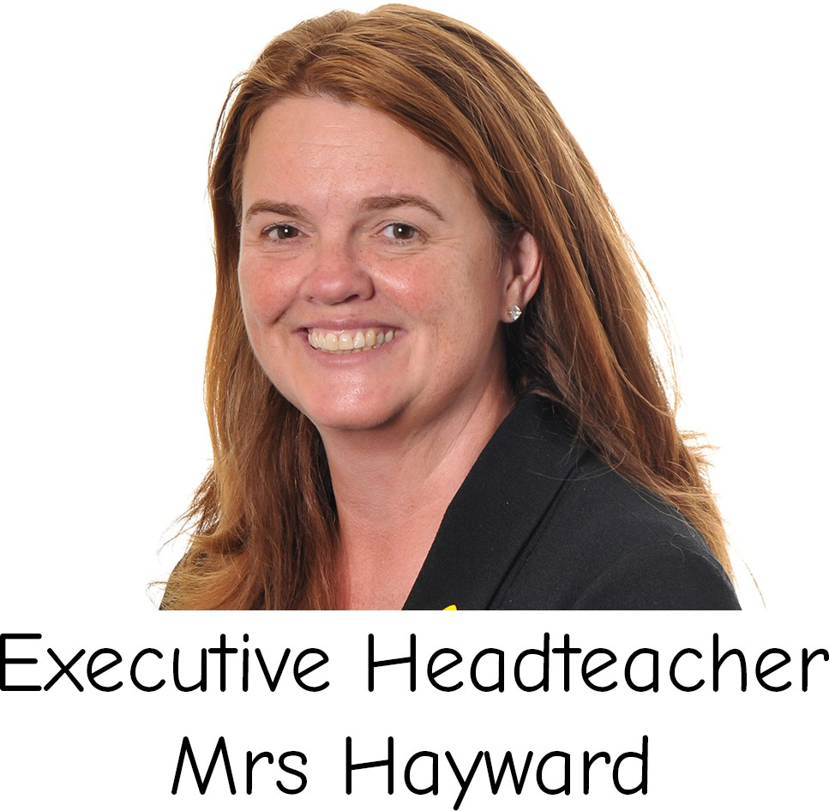
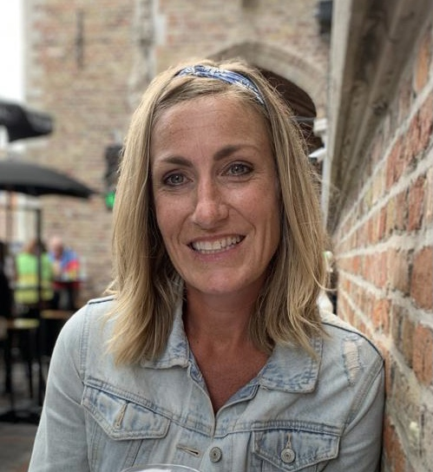
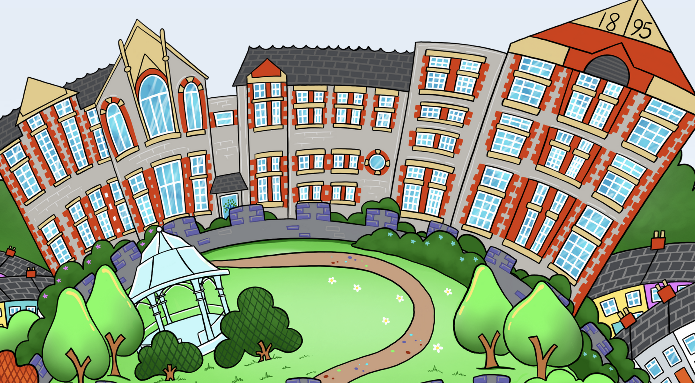
Cadoxton Primary School Victoria Park Road
Barry
Vale of Glamorgan CF63 2JS
Janet Hayward Rhian Milton
Executive Head of School
Head Teacher
Our school is a special place for children and their families to feel part of a learning community. We value every child, and not only want them to receive an excellent education but also to feel happy safe and secure, providing an environment in which every child can thrive. Our Cadoxton Way is based upon children being hooked on authentic learning experiences, a balance of knowledge and skills that are purposeful and engaging. Our innovative 21st Century curriculum is built on curiosity and inquiry that is informed by children’s interests and provides them with the skills and experiences to become confident lifelong learners. We are fully committed to the ambition of the Curriculum for Wales, for our children to be:
Ambitious, capable learners
Ethical, informed citizens
Healthy, confident individuals
Enterprising, creative contributors
Cadoxton works in partnership with Oak Field Primary School, collaborating to achieve the best for children across the two schools. We want to always work in genuine partnership with parents and the wider community, nurturing a love of learning aiming to support and equip every child with the tools they need to succeed in life. ​ This is the Cadoxton Way! Learning and Growing Together, Being our Best Forever!

Slide 3
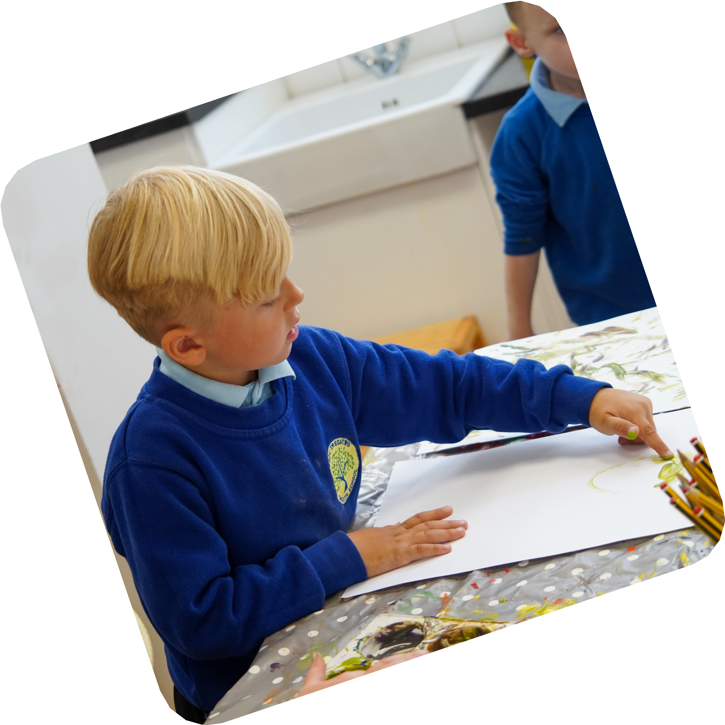
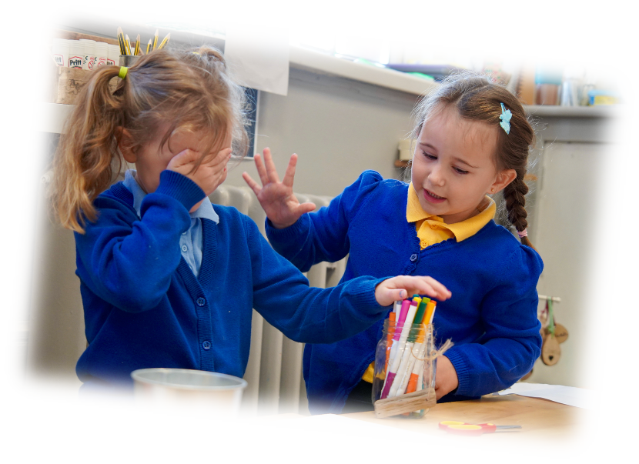
Our Mission
Learning and Growing Together, Being our Best Forever!
Our BeHaviours
Be Safe
Be Respectful
Be the Best you can be
Be kind!
Our actions:
Ready to Learn – I can always be committed to knowing how to be Self-regulated, equipped, determined, and ready to say ‘Yes!’ to great learning experiences on offer every day!
Resourceful – I can have lots of fantastic ideas to contribute and I can work well in groups as well as on my own
Reflective – I can think about what I am learning, I can listen to others’ ideas and opinions, and I can always look for ways to improve and learn even more
Resilient – I can have a positive approach to learning, and never give up even if I find a task difficult or challenging
Responsible – I can always make the right choices and think for myself; I can always be in the right place, at the right time, doing the right thing, in the right way!

Slide 4
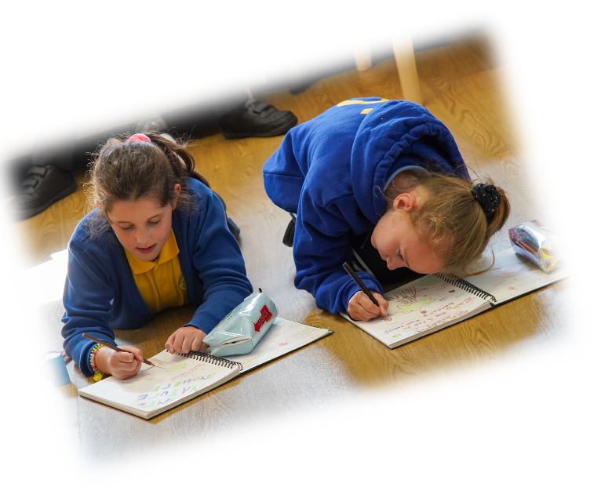
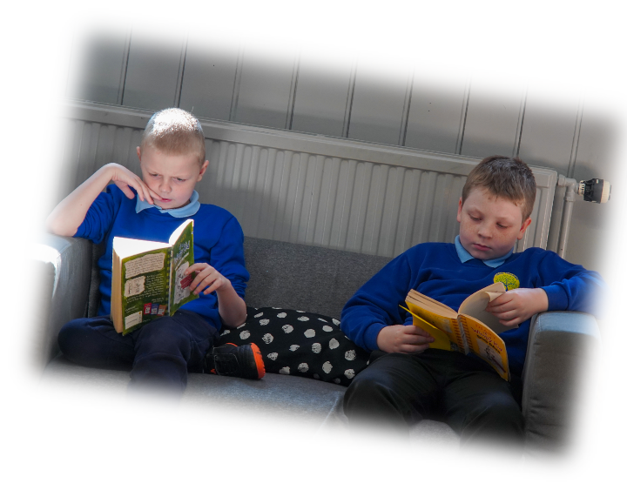
Aims
School Vision
Our mission statement and school aims have been created and are owned by our children, staff, governors and parents. We are a community school who put well- being at the heart of all we do and we are committed to ensuring that every child can reach their full potential and thrive. We endeavour to develop a culture where we all believe in ourselves and each other, we take risks and challenge one another to be better.
To empower ambitious, capable learners, ready to learn throughout their lives
To prioritise positive relationships ahead of everything else
To create enterprising, creative contributors, ready to play a full part in life and work
To shape ethical, informed citizens of Wales and the world
To foster healthy, confident individuals, ready to lead fulfilling lives as valued members of society
To offer a dynamic and innovative curriculum that challenges, excites and inspires us all to learn in a twenty-first century way.
To commit to creating an inclusive, caring and happy environment in which children feel safe, secure, valued and respected.
To promote a sense of belonging to the school and wider community.
To provide an inspiring and challenging curriculum that reflects our community and meets the need of every child.
To teach children how to be a good learner so that they are empowered to lead their own learning.

Slide 5
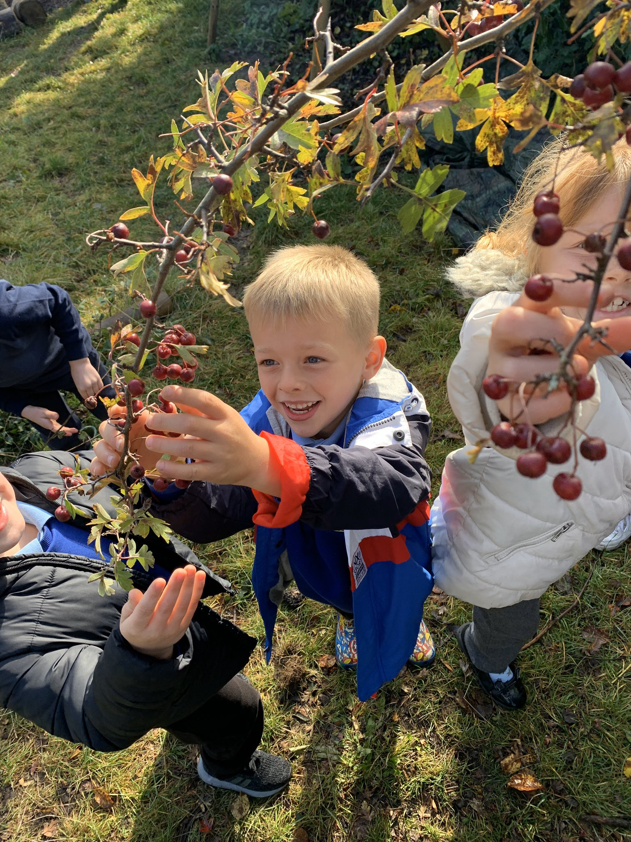
Our School
Our school is an English medium, Community Primary School with approximately 500 pupils. Children begin in our Nursery after their 3rd birthday and stay with us until the school year in which they are 11 and transfer to Secondary School. The school serves the ward of Cadoc which includes the village of Cadoxton, part of the Treharne estate. The school has a long and interesting history; being built in 1879 it was the first Board School in the town of Barry.
During the First World War the school was used as an army barracks.
Since that time there have been many developments in the history of the school, including
the extensive renovation of the Junior building in 1993 and most recently the amalgamation of the Primary School with the Nursery. Many first time visitors are surprised to see how the 21st Century interior of the building is a stark contrast to the outward appearance of this imposing Victorian building.
Admission Policy
Places can be applied for via the Vale of Glamorgan Local Education Authority who are responsible for admissions. Children who are four years of age before August 31st are eligible for a place in the Reception class in the September of that year. Nursery children begin the term after their third birthday. Admissions are accepted through the Vale of Glamorgan Council. A pre-admission meeting and school tour happens prior to entrée to school with the head of school.
The Nursery accommodates 100 children, with 50 places in the morning and 50 in the afternoon. All other Year groups from Reception to Year 6 have 60 places. All children are
eligible for a place at Cadoxton Primary School provided that there are available places
School times
Absences from school
It is essential for children to have good attendance so that they have their full right to
education. There is a proven link between attendance and attainment at school. Last year, our attendance figure was 94% overall. Children are not permitted to leave school during he day and if children are ill, all absences should be explained, by seesaw, email or telephone call. Schools have a legal duty to publish attendance figures and to promote attendance. Equally, parents have a legal duty and responsibility to ensure that their children attend school on a regular basis. The school will contact parents if no explanation has been received. If an unauthorised absence continues for a school week or there is a pattern of occasional absences, the school will contact the Educational Welfare Officer who will contact the home.
Nursery
Morning Session: | 9am-11:30am
Afternoon Session | 12:30pm-3:00pm
Reception-Year Two |  | Year Three-Year Six
Doors Open: | 8.45am | Doors Open: | 8.45am
School Starts: | 9am | School Starts: | 9am
Pick Up: | 2.55pm-3pm | Pick Up: | 3.10pm

Slide 6
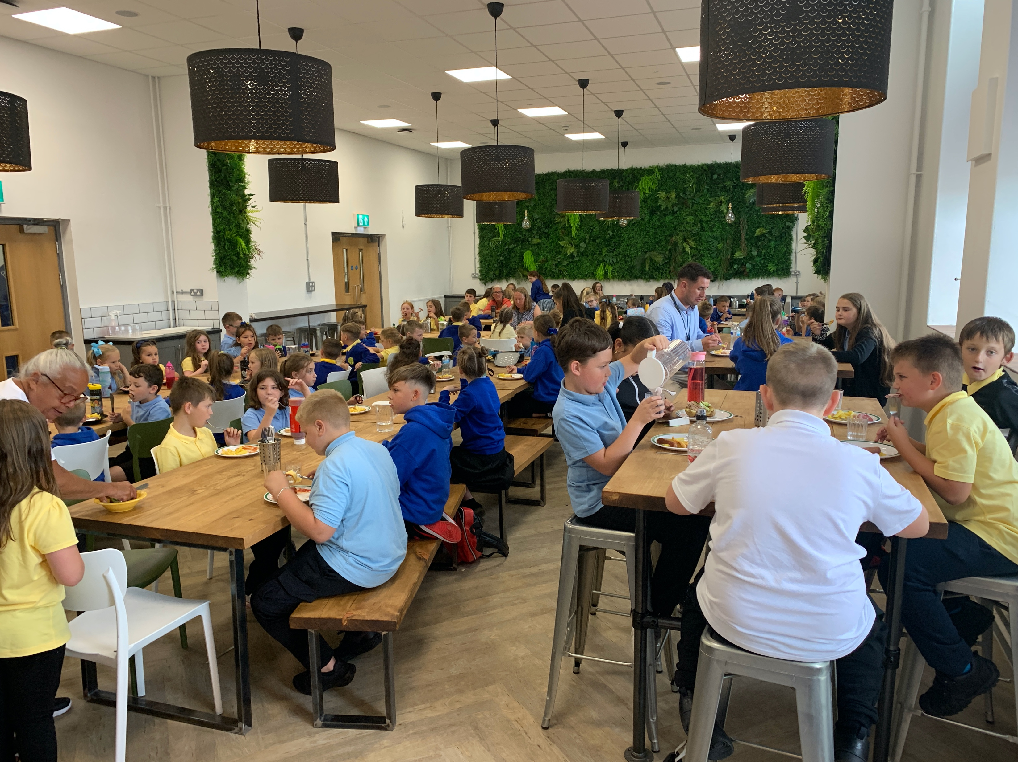
Breakfast club
Welsh Government provide a free Breakfast Club service for children in all year groups. Our breakfast club is run out of multiple locations with children in year groups phases to ensure they have the right start to their day. Drop off is 8-8.15am and food is served in school cafeteria.
Breakfast club Lead: Hannah Cogbill
Breakfast club coordinator: Natasha Cockram
If you wish your child to attend Breakfast Club, please contact Hannah Cogbill CogbillH2@hwbcymru.net as a weekly attendance form needs to be completed to ensure the right ratios of staffing.
We offer a range of after school clubs. Some clubs are age specific and will be limited to maximum numbers for health and safety reasons.
Please note these activities must not be relied upon for childcare as they are run by teaching staff and may be cancelled.
We are however running a pilot paid for childcare club that runs our of our school café. This runs from 3.15-4.30pm Monday- Thursday and supports provision for working parents. Places are limited and places are arranged via the school office. The staff ratios are worked out weekly once parents have booked on using parent pay. A member of SLT is always on the school site until the end of the club.
Transition
We have arrangements in place to support the transition of children into our school throughout the year. These arrangements include meeting with a member of the Leadership Team, a visit to the school
Pencoedtre High is our Cluster Secondary School and the majority of children transfer there at the end of Year 6. A great deal of effort is made to ensure a smooth transition between schools. During their final primary year our children take part in a series of transition events to allow them to form relationships with children from the Pencoedtre Cluster. The Year 6 children visit Pencoedtre High School for both curriculum and social development. When needed, additional transition links are set up for pupils with specific needs.
We also have procedures in place to ensure the smooth transition from year group to year group through moving up days and transition meetings.
After-school clubs

Slide 7
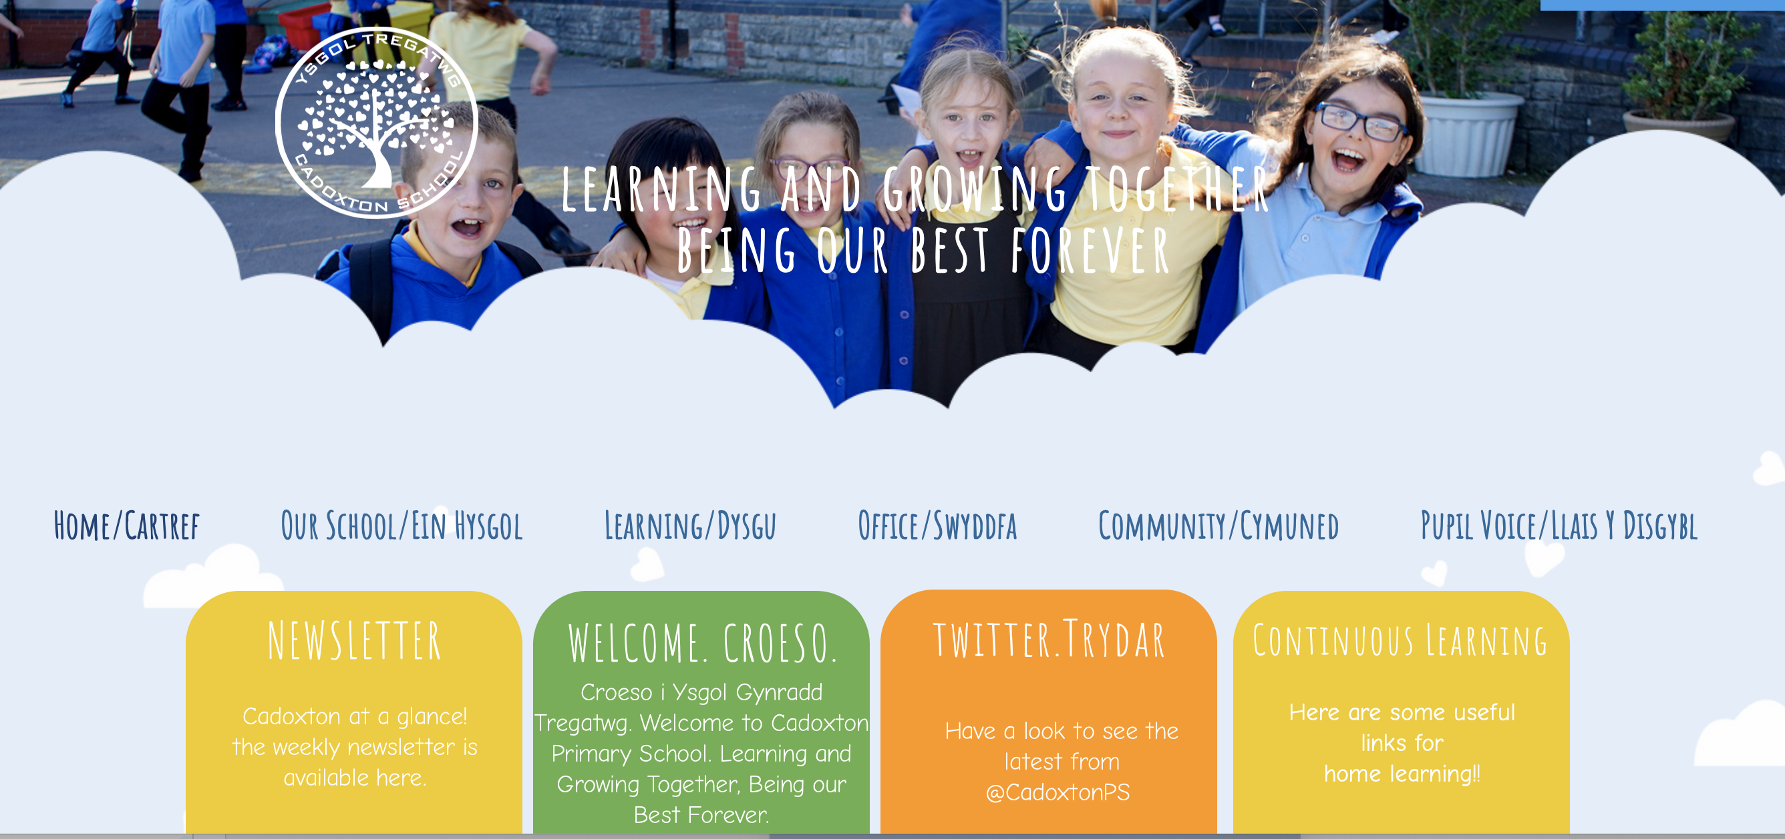
School Communication
In order to pay for school lunches, uniform and any trips you will need to have a ParentPay account. This can be set up by contacting the school office.
Lots of our school information can be found on our school website: https://www.cadoxtonprimaryschool.com
We have a weekly newsletter that goes out
every Friday and this includes whole school
information and highlights of what has been
going on. This is available via seesaw, the
website and our school twitter account.
The school has a Twitter, Facebook
and Instagram account. They are
used to share school Information,
celebrate our success and
promote upcoming events.
Seesaw is an app that we use that
will share information that is specific
to your child and their class. You
will be able to share their digital
learning journey but kept up to date
with everything that is happening.
Transition

Slide 8
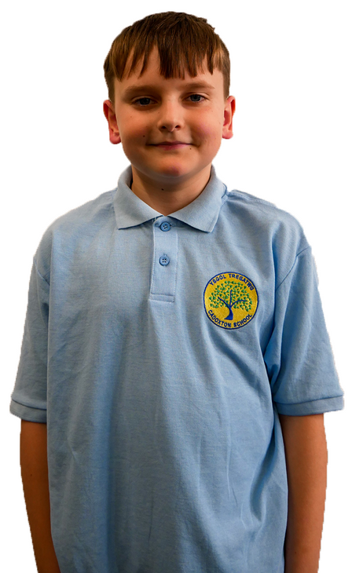
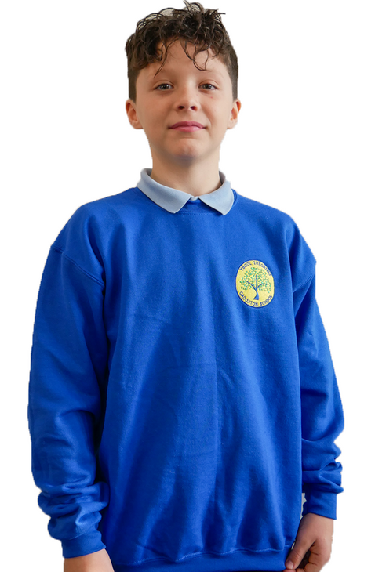
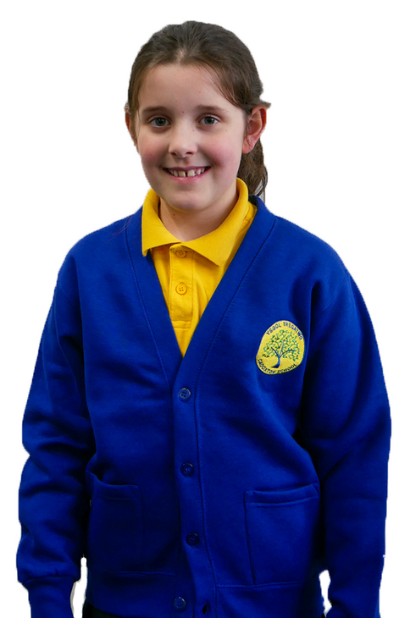
School Uniform
All children need to wear school uniform. School uniform helps our children to feel part of our community. It identifies our pupils when representing the school in the community or on visits and has a recognised effect on children’s behaviour. In accordance with Welsh Government (WG) regulations, we have ensured that the majority of the uniform is available from local stores or supermarkets. Please ensure your child’s name is clearly marked on all items of clothing so that it can be identified.
To order school uniform you will a ParentPay account. To set this up please contact
Book Bag £6.50
Sweatshirt £10.50
Cardigan £11
Hoodie £14.50
Polo £8.50
We have regular second hand uniform sales that happen at interim points throughout the year and a lost property store just inside reception.
Book bags with our logo, can be purchased from school and we encourage every child to use our home lending system. Children can choose a book to share with you or as they learn to read, a book to read to you.
Transition
School Book Bags

Slide 9
Staffing 2021
Roles | Name
Executive Headteacher | Janet Hayward
Head of school | Rhian Milton
Assistant Headteacher | Louise Williams Luke Tweedley
Nursery/Reception Year 1/Year 2 Year 3/Year 4 Year 5/Year 6 | Elle Peate Sarah Brookes Hannah Cogbill Julia Adamson
Additional Learning Needs Coordinator | Elle Peate Nursery-Year 3 Louise Williams-Year 4-Year 6
Family Engagement Leader | Natasha Cockram
Admin Officer Finance Officer | Carol Wright Sian Dovey
Caretaker Facilities Manager | Carl Bates ,Tom Pitt Joe Gaughn
IT & Digital Communications Leader | Jack Rowlands

Slide 10
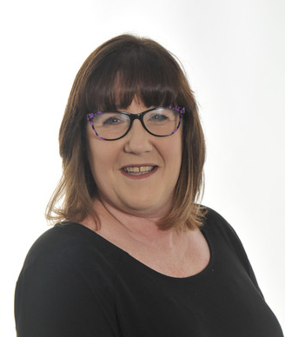
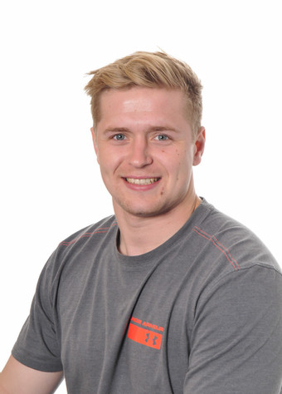
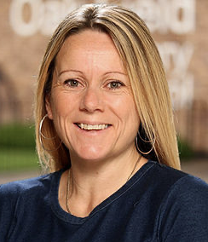
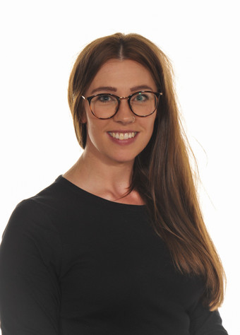
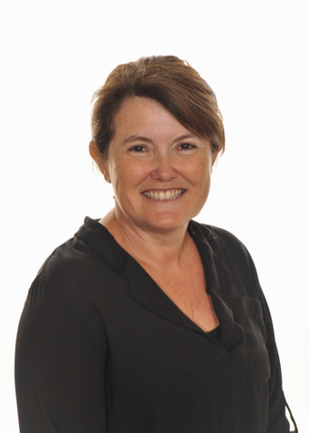
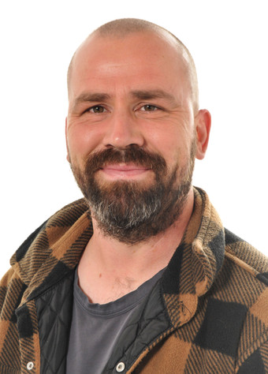
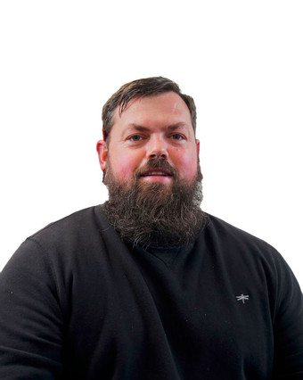
Useful people to know
Office Admin staff
Carol Wright
Jack Rowlands
Sian Dovey
Assistant Headteachers
Elle
Peate
Louise
Williams
Facilities Staff
Tom Pitt
Carl Bates
Joe Gaughn

Slide 11
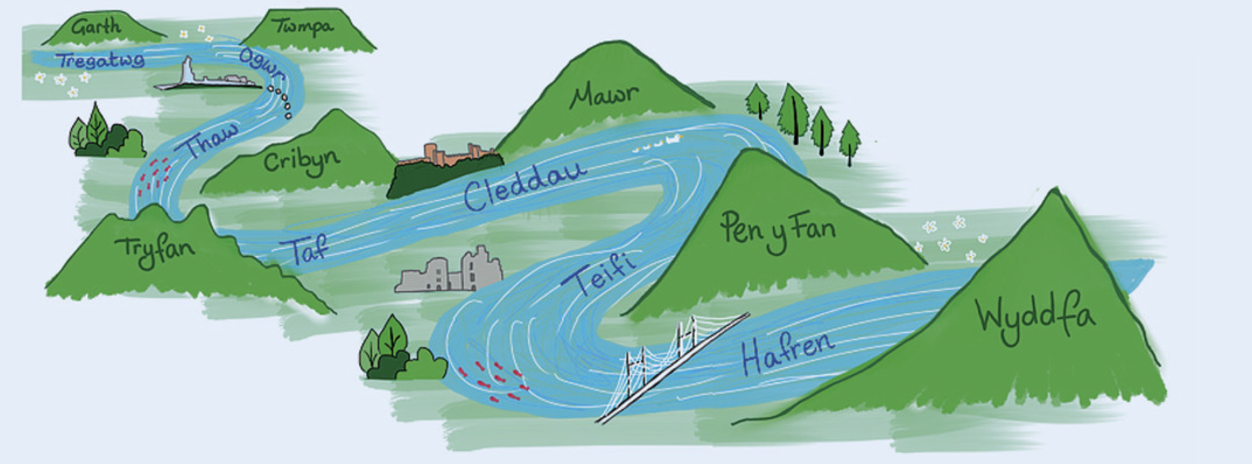
Class Teachers 2022-2023

Slide 12
Governors
Name | Role
Mrs Megan Merrett (Chair) | Co-opted Governor
Mrs Wendy Thomas (Vice Chair) | Co-opted Governor
Catherine Iannucci | LEA Governor
Mrs J Hayward | Executive Headteacher
Mrs R Milton | Head of school
Miss H Cogbill | Teacher Governor
Mrs L Powell | Non-Teaching Governor
Mr Rhys Jones | Minor Authority Representative
Councillor R Nugent-Finn | LEA Governor
Jan Comrie | Co-opted Governor
Mr Sean Murphy | LEA Governor
Mrs Elyn | Parent Governor
PSCO Dom Bury | Co-opted Governor
Mrs Rachel Cox c/o School | Clerk to Governors

Slide 13
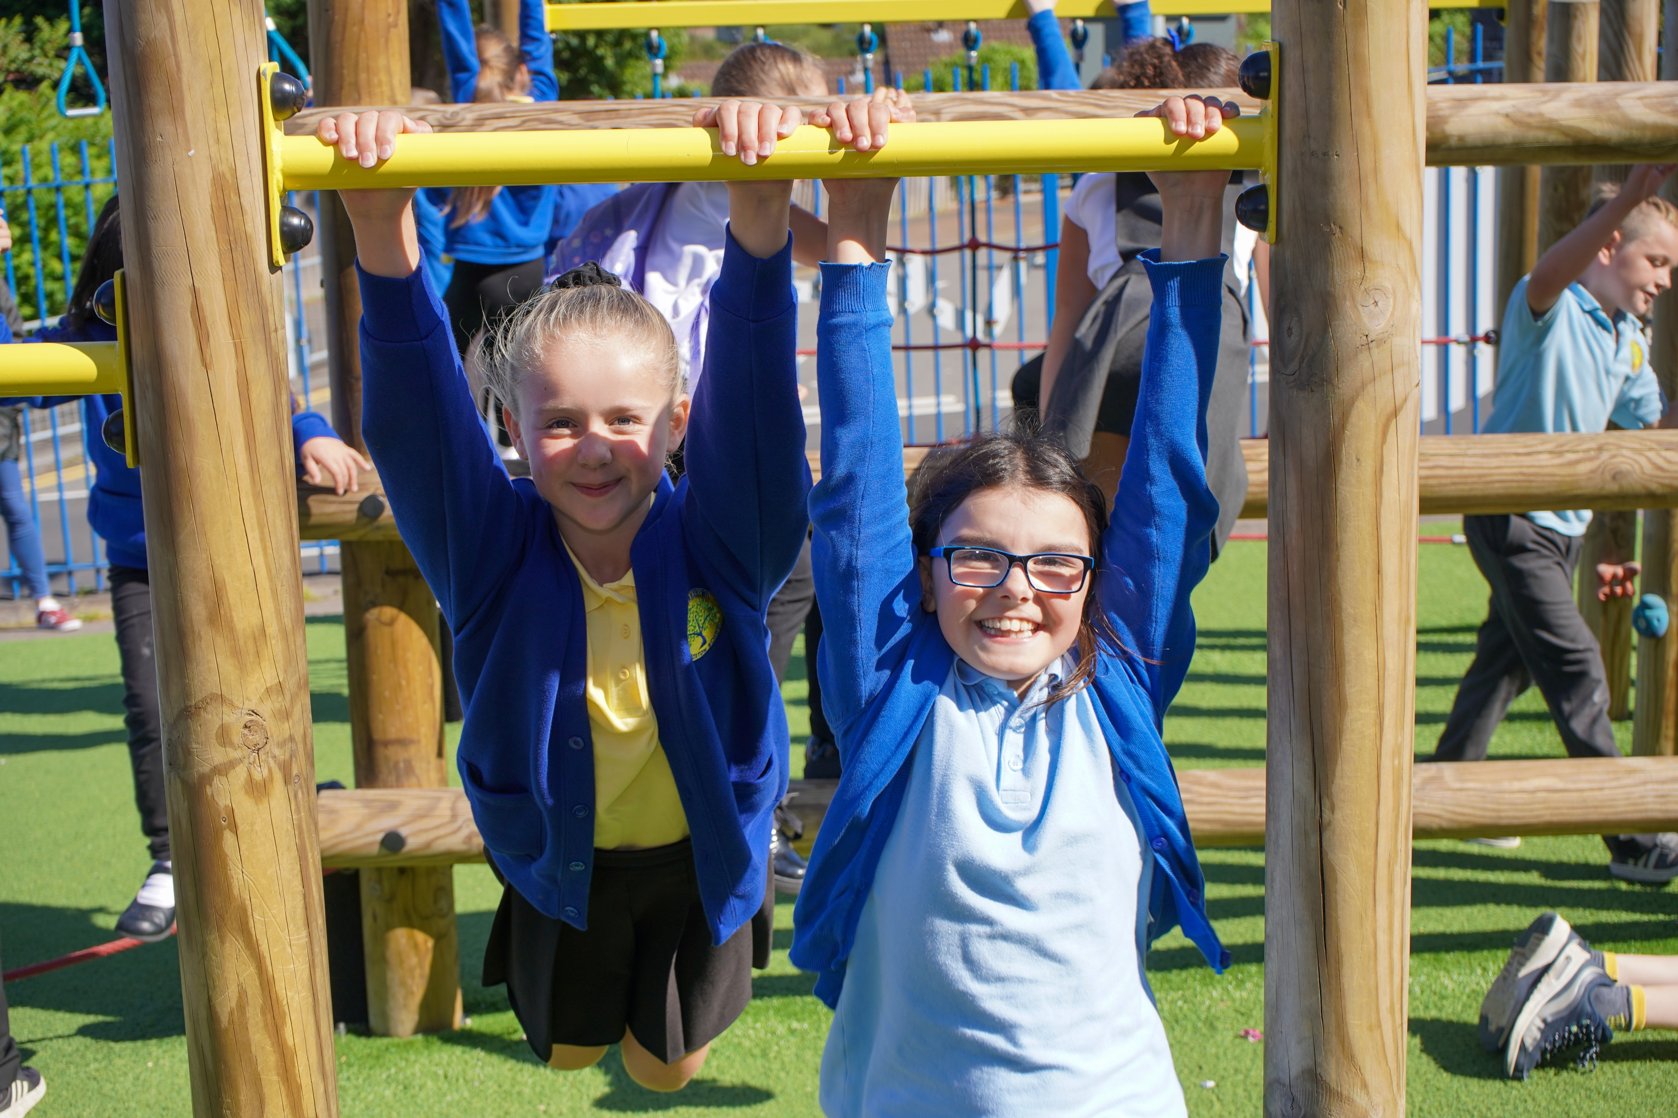
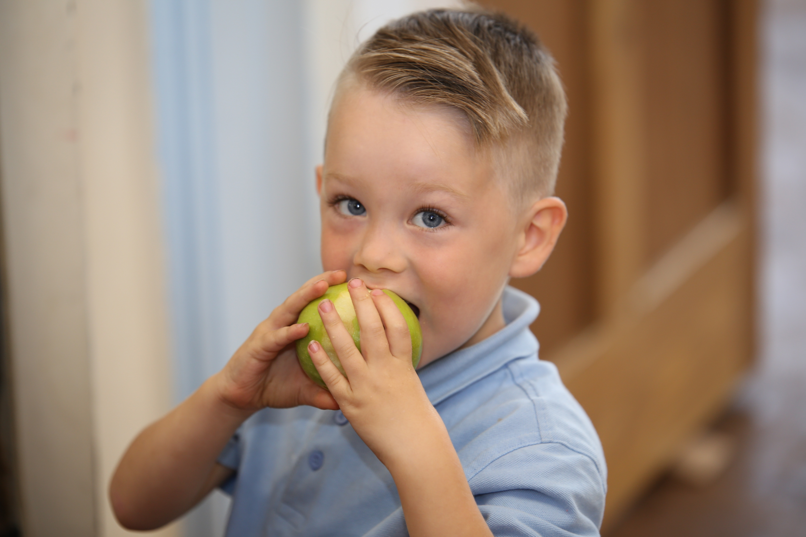
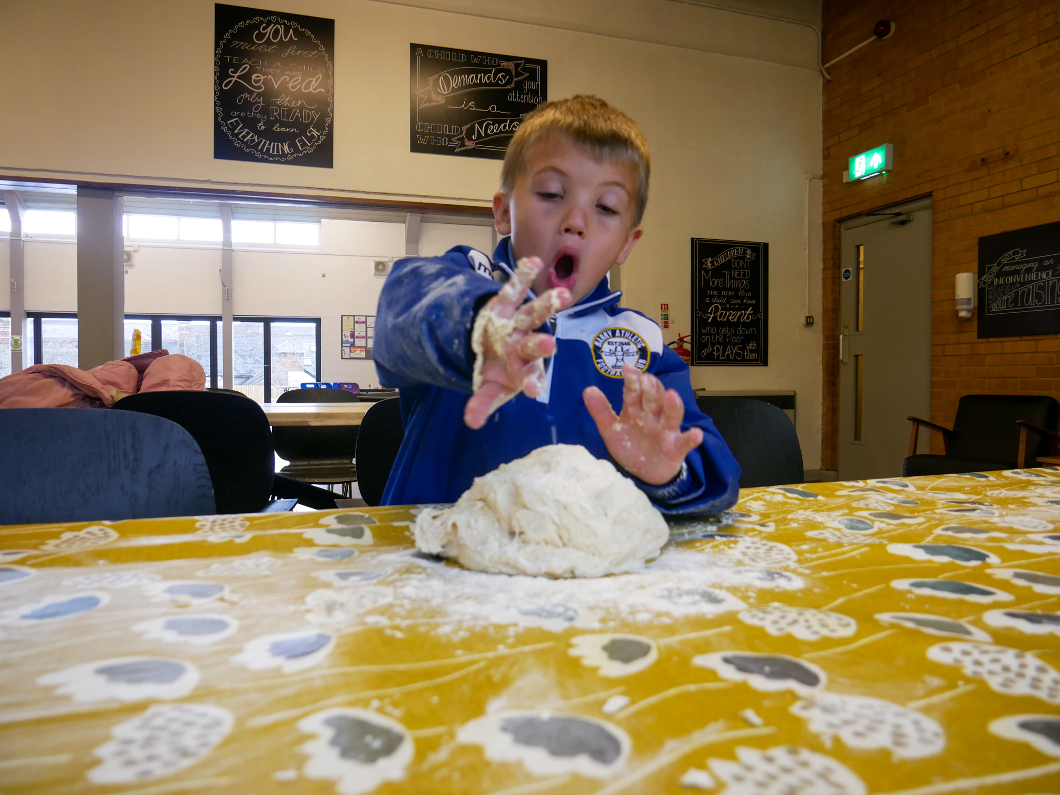
Break and lunch time
Active Break Times
Children in Nursery to Year 2 have continual indoor/outdoor access throughout the day. Children from Year 3 to Year 6 start their day with an active start and then have access the outdoor areas during their morning break time and lunchtime.
Drinks, Snacks & Free Milk
All children are required to bring a water bottle into school each day. Children are able to access fresh water throughout the day and encouraged to drink regularly. As a Healthy School, we encourage the children to only drink water and milk.
Nursery-Year 2 will have access to continuous healthy snack throughout the morning to ensure that no children goes hungry. The children will also be offered free milk.
For Year 3 and Year 6 there is a break during the morning session with snack available. We ask that parents make a contribution of £1 a week and this can be paid for the term via parent pay. You may also wish to send fruit for your child to eat at playtime. A healthy cereal bar is permitted, but please note that it should not contain chocolate
Food and Growing
We take the importance of food very seriously and a big part of our health and well-being curriculum is to ensure that the children learn about health choices and nutrition. Cooking and understanding food is therefore a big part of daily life.

Slide 14
lunch time
Healthy Lunch
Rec-Year 2 children now have a free school lunch provided for them daily by the Welsh Government. We place considerable emphasis on the importance
of food and we recognise the opportunity it gives children to socialise and interact whether they have a school meal or bring a packed lunch. School staff and midday supervisors care for the children during this time and will encourage all children to eat their meals, interact with each other.
Our school meals are managed by Big Fresh and we have an excellent kitchen staff including head chef Felix who plays a big part in school life. We change the menu regularly to ensure that it is seasonal and reflects feedback from our children and parents.
We offer a secure payment system for school meals called ParentPay. ParentPay allows parents to make payments to a secure online account, accessed by a unique username and password. Parents will receive these unique usernames and passwords at the start of the school year. All school meals must be booked and paid for online, via ParentPay, in advance. All pupils will be provided with a copy of the School Menu to enable parents to make informed choices. Please advise the school if your child develops a food allergy, or has any other dietary requirements, for example, vegetarian, Halal, etc.
Some parents prefer to provide a packed lunch and drink for their child. When this is the case we would request, for safety reasons, that you do not provide drinks in either cans or glass bottles. As we are a “Healthy School” we would encourage parents to provide a healthy and nutritious packed lunch. Anything with nuts is not permitted due to children with nut allergies.
If you are in receipt of certain qualifying benefits, you may be entitled to free school meals. Please contact the school office to find out more.
This leaflet is available to give you an idea of what should be in a healthy packed lunch box.

Slide 15
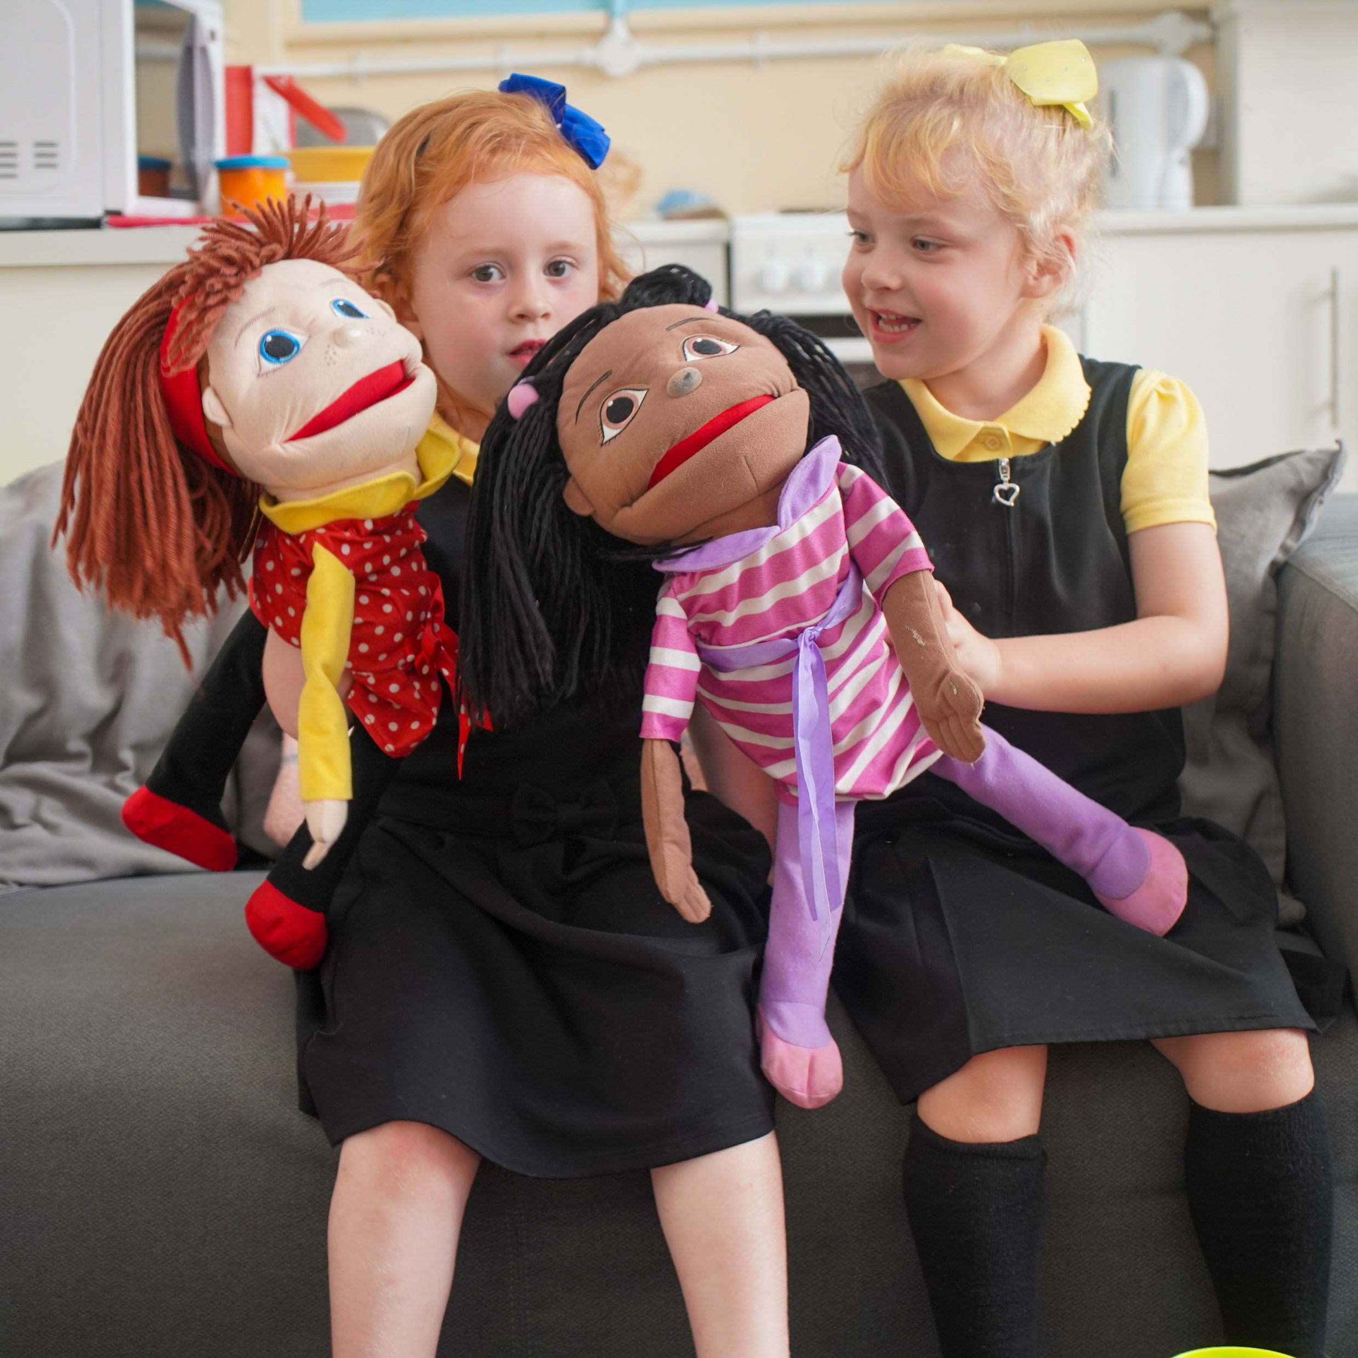
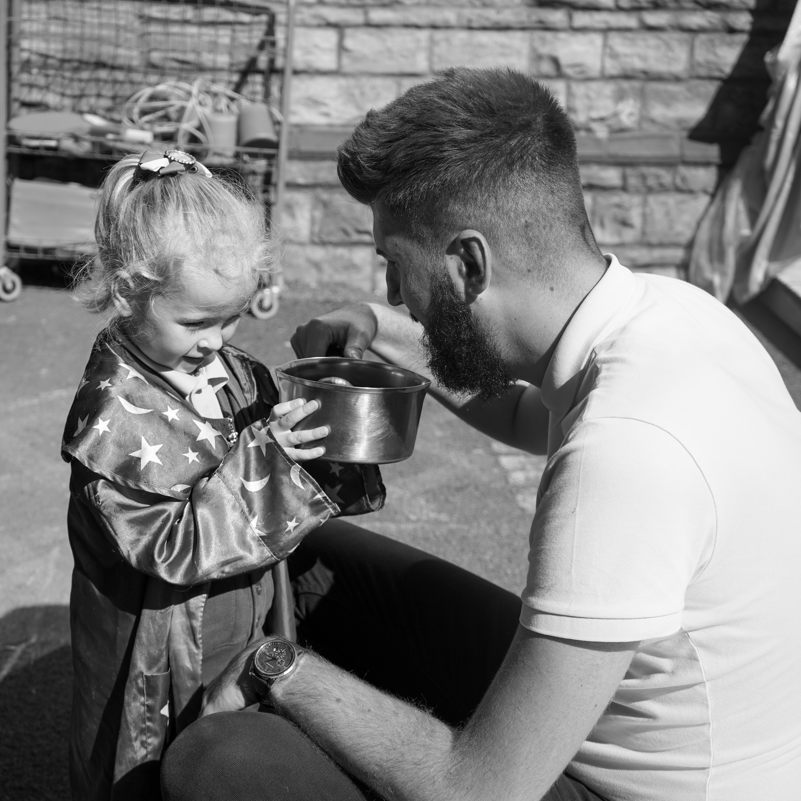
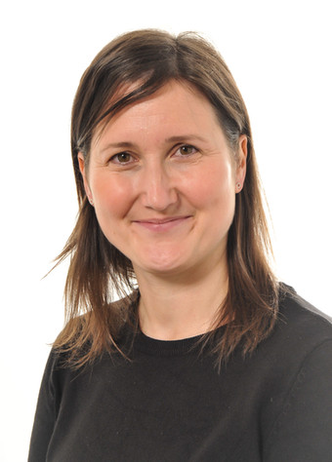
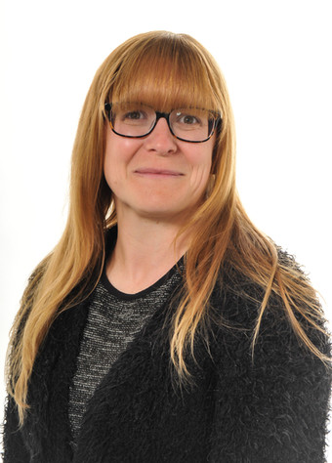
ALN- Our Vision is for every child to reach their full potential!
As a school we ensure the needs of all children through high quality teaching and learning provision. Our Universal Provision includes:
whole class teaching
effective differentiation
collaborative group work
individual and small group interventions
appropriate and reasonable adjustments to enable access to the school environment, curriculum
and facilities.
During their time at Cadoxton, most children will make expected progress in their learning from their starting points. If a child is not progressing, we will gather observations, use assessment data and seek to work in collaboration with outside agencies / professionals to identify any additional learning needs. A wide range of evidence will be gathered over time, including:
assessment tools, frameworks and questionnaires
standardised assessments
observational data
formative assessments of day to day learning
monitoring progress over time
assessments from other agencies e.g., Paediatrician.
A child not moving forward in their learning is characterised by progress which:
is significantly slower than that of their peers starting from the same baseline,
does not match or better previous rate of progress,
does not close, or widens, the attainment gap between the child and their peers, despite the provision of support aimed at closing that gap.
Identification of Additional Learning Needs (ALN)
When pupils do not make the expected progress with Universal Provision and following thorough investigation and evidence gathering, a child may be identified as having ALN.
Elle Peate- Lucie Wardle Katy Turnbull
Lead ALNco. Support ALNco. Support ALNco

Slide 16
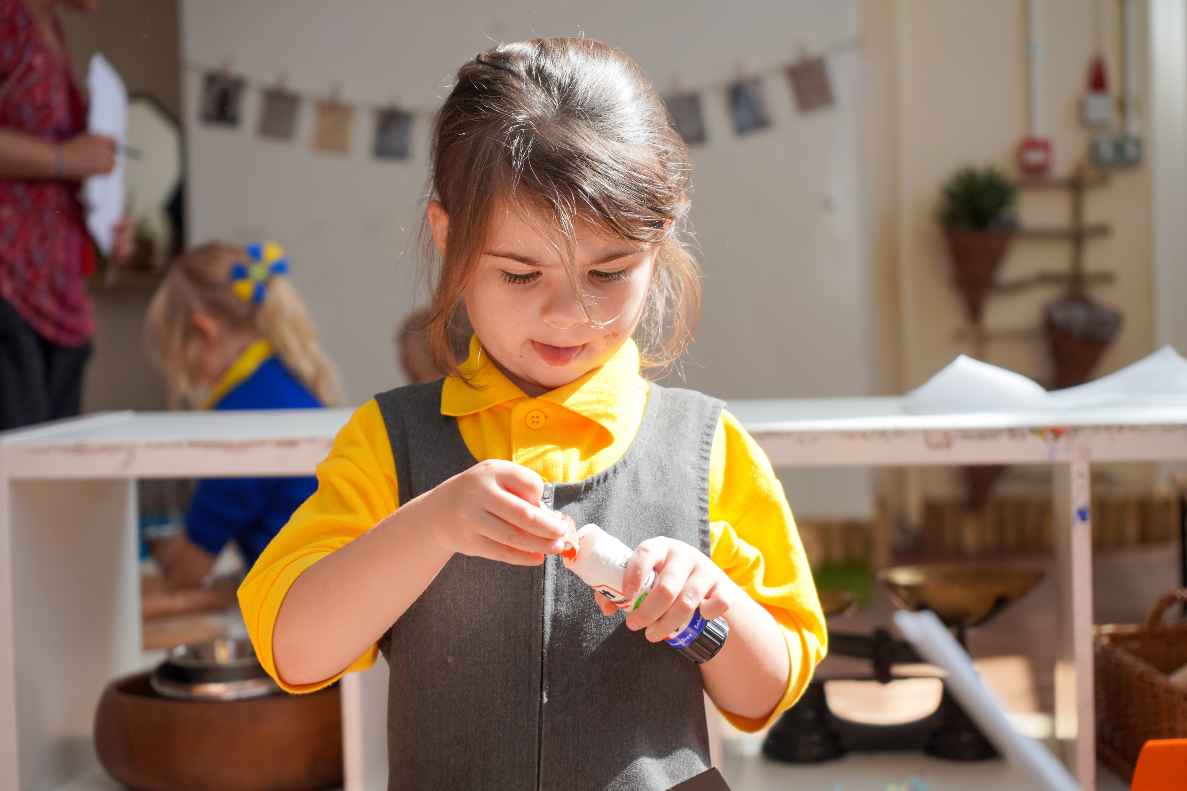
Safeguarding
All staff at Cadoxton Primary School have regular up to date safeguarding training that equips them to recognise and respond to any welfare concerns. These concerns are passed to the Designated Senior Person for Safeguarding who follows strict guidelines on how to deal with any issues raised. We take our duty of care very seriously and at we work with outside agencies closely to meet the needs of our children and their families. We use a school system called ‘My Concern’ that allows us to record and track all safeguarding concerns across the school. This is a secure platform and we follow all GDPR guidelines to keep the information safe and secure with only the necessary adults having sight of the data.
Designated Safeguarding lead in Cadoxton:
Janet Hayward: Executive Headteacher
Rhian Milton: Head of School / Interim Head
Luke Tweedley: Assistant Head
Elle Peate: Lead Practitioner
Equity and inclusion
The Governors and staff promote equal access to all areas of the curriculum for all children, regardless of race, gender, ability, disability, faith and cultural background. The school has clear policies in place and are committed to providing equality and an inclusive education. We expect respect for all within our school and the wider community.
Looked after children
We work in partnership with the Vale of Glamorgan council and follow a a duty to safeguard and promote the education of Looked After Children. We aim to provide a safe and secure environment, where there is belief in the abilities and potential of all children, including those who are looked after. We support our Looked After Children and give them equal access to every opportunity to achieve their potential and to enjoy learning. Our head of school Rhian Milton is the designated person responsible for promoting the educational achievement of Looked After Children.

Slide 17
Arrangements for the disabled
The school is a Victorian building and is on multiple levels however we have facilities to accommodate disabled children and adults. It is fully compliant with all current regulations. We are committed to inclusion and full access to the curriculum and all aspects of school life for all children. Occasionally Health and Safety issues demand that some exceptions be made. In these instances each case is looked at very carefully on an individual basis and suitable differentiation is negotiated. A full risk assessment will be taken prior to admission.
School security
The safety of our children is paramount and there is CCTV coverage of the school site. All visitors must report to the main office located at the front of the school where our administration team are on hand to answer any queries you may have and to welcome visitors to the school. External doors leading into the school require electronic entry fobs to ensure the whole school site is secure. Deliveries are only able to enter through the main school gates operated by our admin team. Our school facilities manager is Joe Gaugn who manages all of the safety and security of the building including our sports hall, gardens and community centre.
Access to Information - GDPR
The school will retain records on each individual child. These provide a personal and academic profile as progression is made throughout each year. Records are available for parents to inspect at school and copies can be made to be taken away should this prove necessary. It is a statutory obligation that records should be made available within 15 days – but normally it is possible to arrange for them to be seen more quickly than this.
Parents who wish to inspect documents relating to the school’s curriculum should contact the Headteacher.

Slide 18
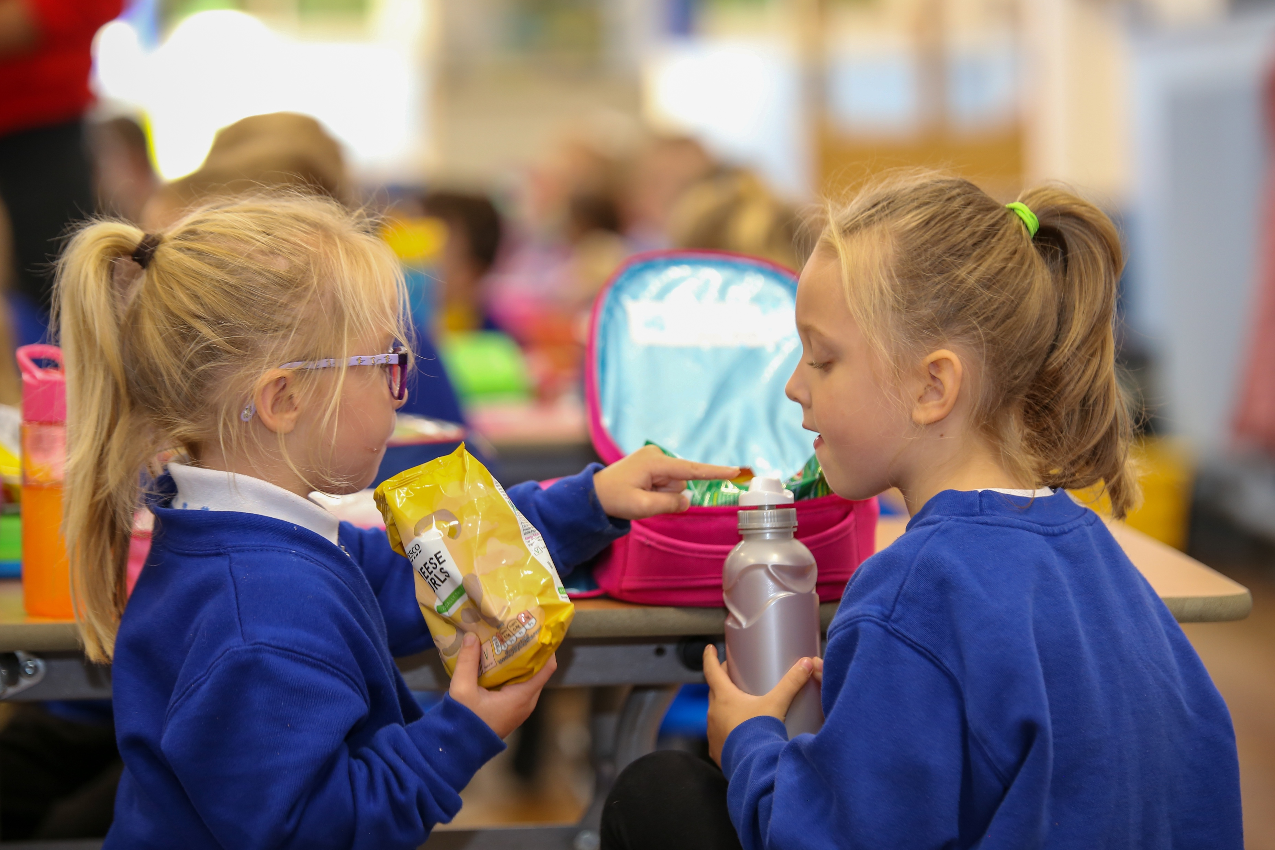
Health and safety
We aim to ensure that children are safe and secure at all times. The school adheres to the guidelines outlined by the4 Vale of Glamorgan City Council regarding Health and Safety in Education.
Any health and safety concerns are to be reported to the Head of school. When appropriate these issues will be brought to children's or parents attention via our communication systems. Personal and Social Education sessions also address any Health and Safety issues. The school works closely with our community, such as the police and the traffic safety team. Any issues are monitored and reviewed on a regular basis. Regular fire drills are undertaken and the school is equipped with appropriate safety equipment which are checked for compliance regularly. Risk assessments have been undertaken on potential hazards and educational visits. We use a secure system called Evolve to do an in-depth risk assessment of every off site
Visit.
Visitors MUST report to the school office where they will be asked to sign in and wear identification badges if working in and around the school. Parents should not enter the school via any other door but the main school reception during the school day. All staff have a DBS check, this includes contract workers.
There is a limited amount of parking available in the school car park. The back car park is closed off during drop off and pick up times to ensure the safety of all our children. Only blue badge holders are permitted to park in the disabled parking bays. Please be considerate to pedestrians and other drivers when parking near to the school and where possible parents and carers should walk to school.
The school site is secure throughout the school day. It is monitored by CCTV cameras, 24 hours a day.
Please note that dogs are NOT ALLOWED on the school site. The school has a strict NO SMOKING policy on the whole site. Any person using inappropriate language within the school grounds will be requested to leave.
GDPR
The General Data Protection Regulations (GDPR) replaced the Data Protection Act 1998 on 25th May 2018. The school is now required to tell all data subjects about the data that is collected about them and how it is used. Below are our policy and privacy notice.

Slide 19
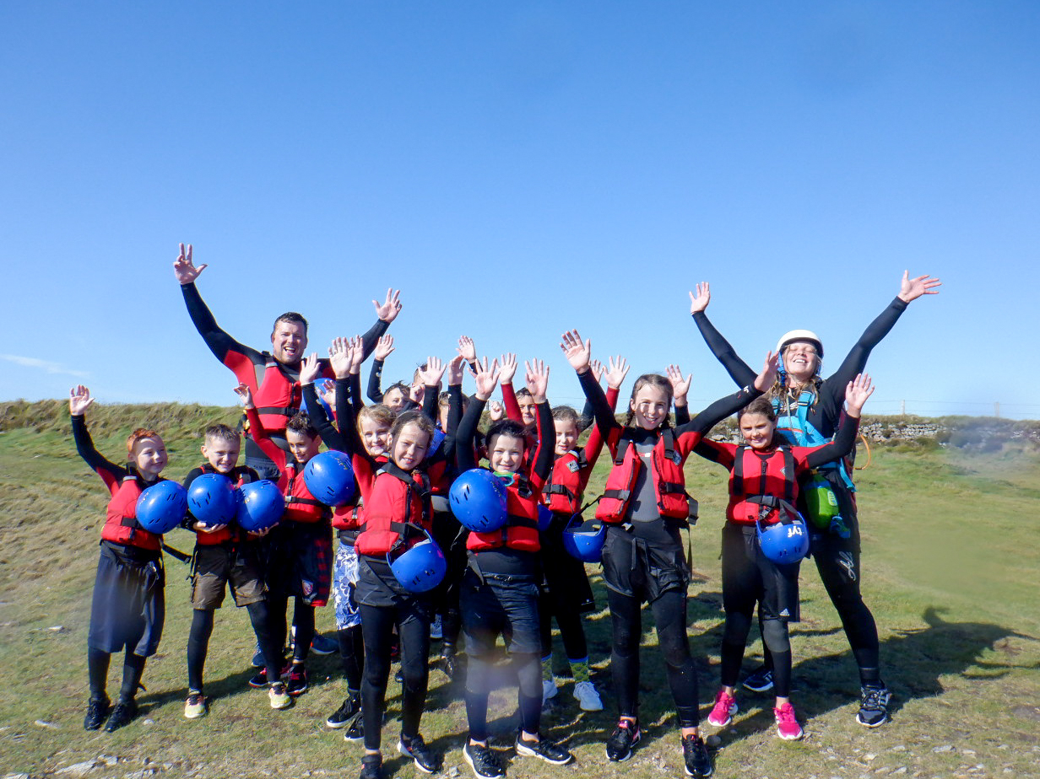
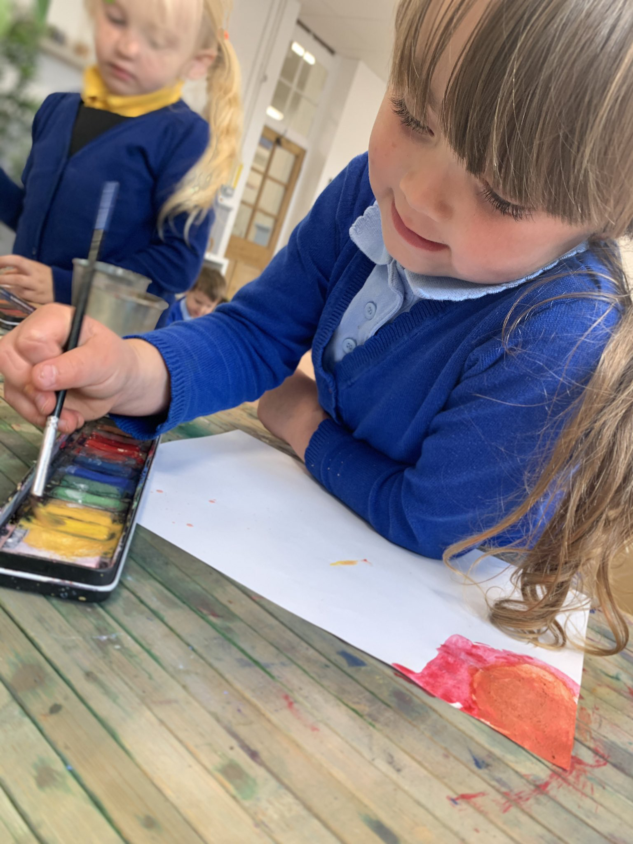
Policy on Charging for School Activities
The school’s educational provision and most of the activities organised by the school are financed via funds received from Vale of Glamorgan City Council. There are, however some valuable educational experiences that cannot be provided by the school without financial support from parents.
Where a visit occurs during school time, a voluntary contribution to enable the visit to take place may be invited. Activities for which voluntary contributions are sought may be cancelled if the cost to the school is not adequately covered. Contributions may also be requested for visiting workshops to support areas of learning and experience. Where possible we subsidise school residentials and school trips to ensure that they are affordable for all. We also endeavour to give plenty of notice to allow parents time to save and be prepared.
The Headteacher, in consultation with the Chair of Governors, will make authorisation of remission in any of these areas.
Complaints
The school follows the Local Authority complaints procedure policy as required by the Education Reform Act. The document is available on our website.
All complaints in the first instance should be addressed to the appropriate person at school. This should be the Head of school. Complaints about actions of a member of staff must always be made to the Head of school in the first instance. Any person against whom a complaint is being made should be informed at the outset.
Should the school and complaint fail to reach a resolution, LA and Welsh Government guidelines and procedures will be followed. However, it is usually possible for queries and problems regarding all aspects of school life to be dealt with effectively by good home/school communication. If you wish to make a formal compliant about the head or executive head of school then you should contact our chair of governors Mrs Sean Murphy. Our complaints procedure is in line with our relationships policy and we endeavour to solve all disputes in a respectful, calm way, ensuring that everyone is safe and protected.

Slide 20
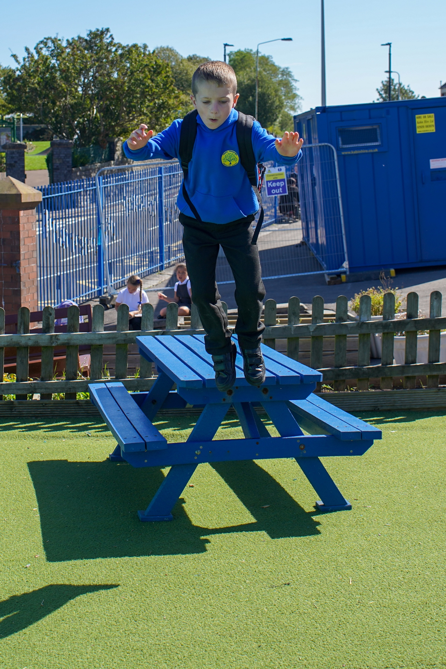
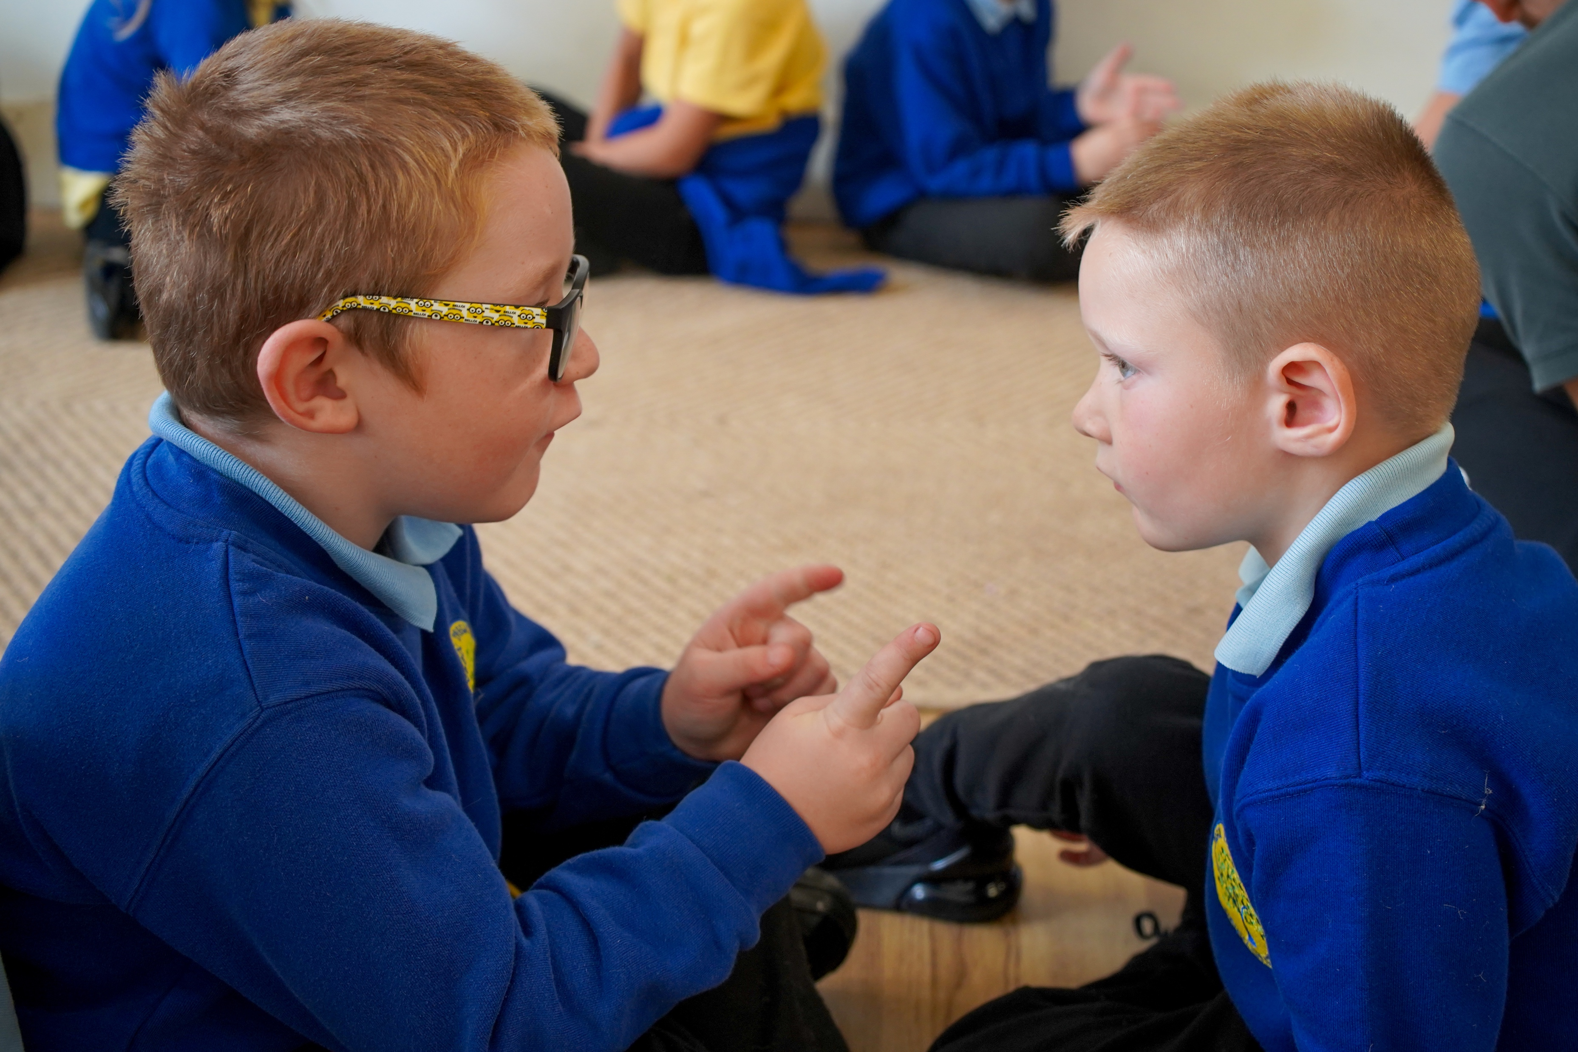
Cadoxton Curriculum: The cadoxton way!
Curriculum for Wales
Four Purposes- our common goals for all our children from 3-16
​
The four purposes of the curriculum are the shared vision and aspiration for every child and young person. They guide and direct everything we do at Cadoxton Primary School. In supporting the development of the four purposes, we set high expectations for all – to raise standards, tackle the attainment gap, and ensures our curriculum supports lifelong learning.
The four purposes are at the heart of our new curriculum. They are the starting point for all decisions on the content and experiences developed as part of the curriculum to support our children and young people to become:
Ambitious, capable learners ready to learn throughout their lives
Enterprising, creative contributors, ready to play a full part in life and work
Ethical, informed citizens of Wales and the world
Healthy, confident individuals, ready to lead fulfilling lives as valued members of society.
The curriculum includes:
6 Areas of Learning and Experience from 3 to 16
3 Cross curriculum responsibilities: literacy, numeracy and digital competence
Progression reference points at ages 5, 8, 11, 14 and 16
Achievement outcomes which describe expected achievements at each progression reference point.
The curriculum is organised into 6 Areas of Learning and Experience:
Expressive arts
Health and well-being
Humanities (including RE which should remain compulsory to age 16)
Languages, literacy and communication (including Welsh, which should remain compulsory to age 16, and modern foreign languages)
Mathematics and numeracy
Science and technology (including computer science)
Bilingualism
English is the main language of communication, teaching, learning and assessment at Cadoxton Primary School. However, the school is committed to promoting the aims and aspirations of the Welsh Government in developing Bilingualism. In our school both English and Welsh will be functional languages. We will promote oracy, reading and writing in both English and Welsh Second Language in informal and structured situations. Welsh will be seen and heard around the school, during school assemblies and concerts, signage and display, lessons and indoor and outdoor activities. We are passionate about being welsh and have shown our commitment by achieveing our bronze and silver siatia Yaith awards for the development of the welsh language.
As a school, we therefore aim to:
● Foster positive attitudes in all learners towards bilingualism
● Provide opportunities for all children to hear and use Welsh in all areas of their learning
● Motivate the children to use Welsh naturally, spontaneously and with confidence

Slide 21
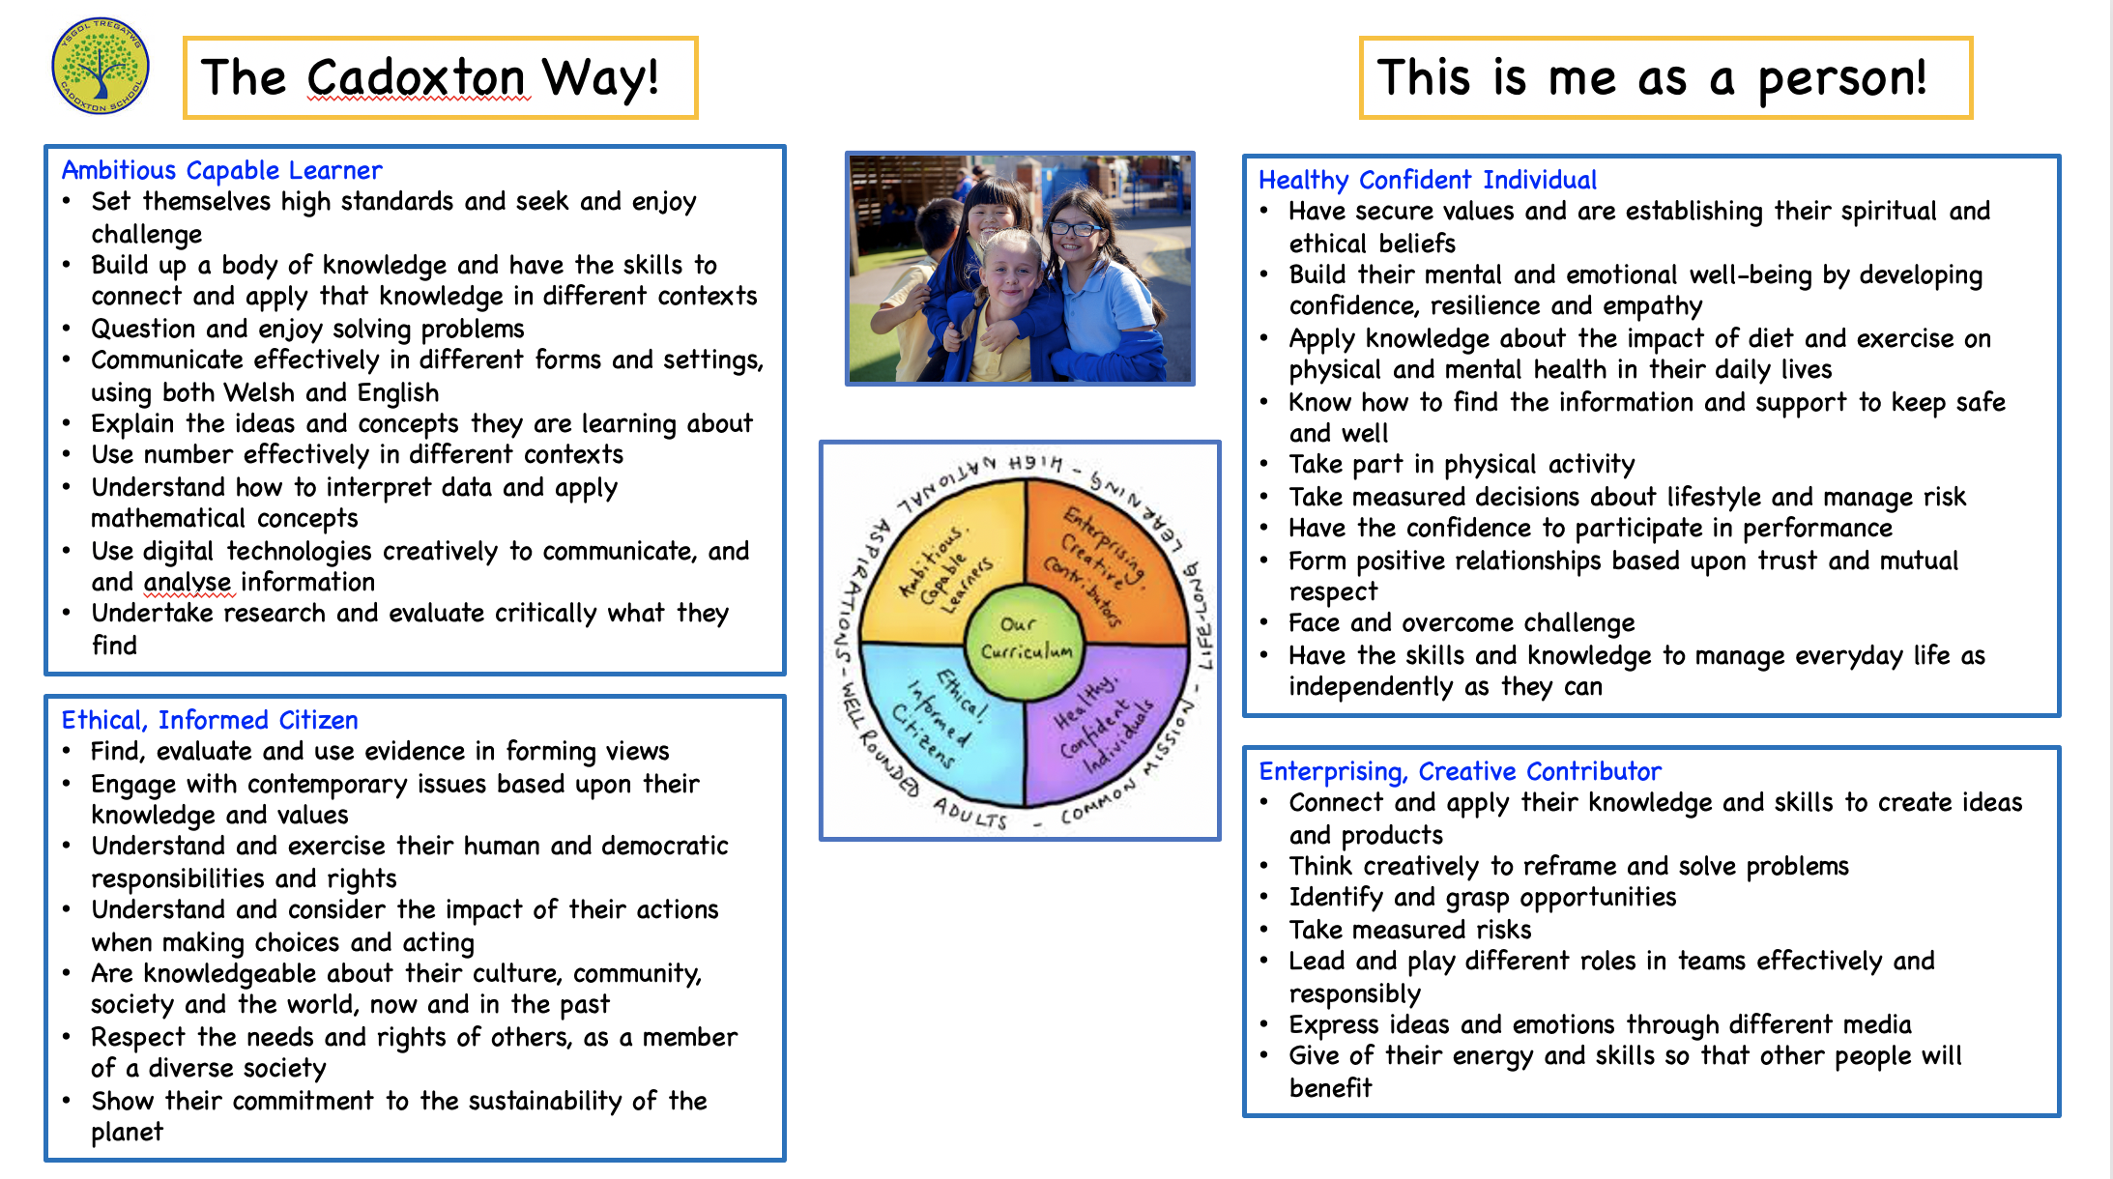
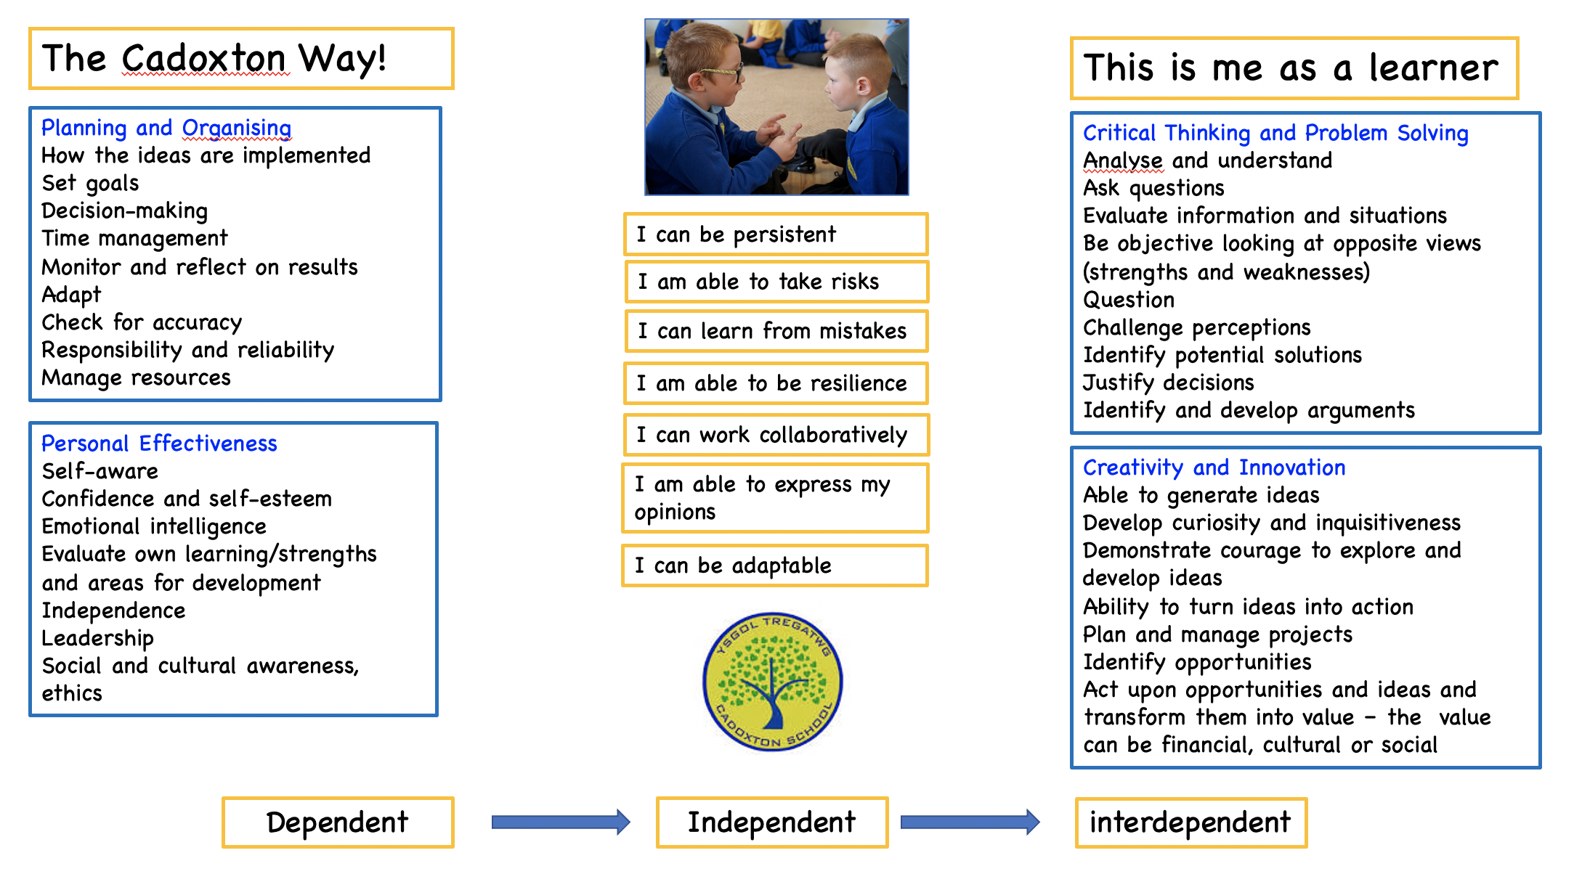
Cadoxton Curriculum: The cadoxton way!
The four purposes
The integral Skills

Slide 22
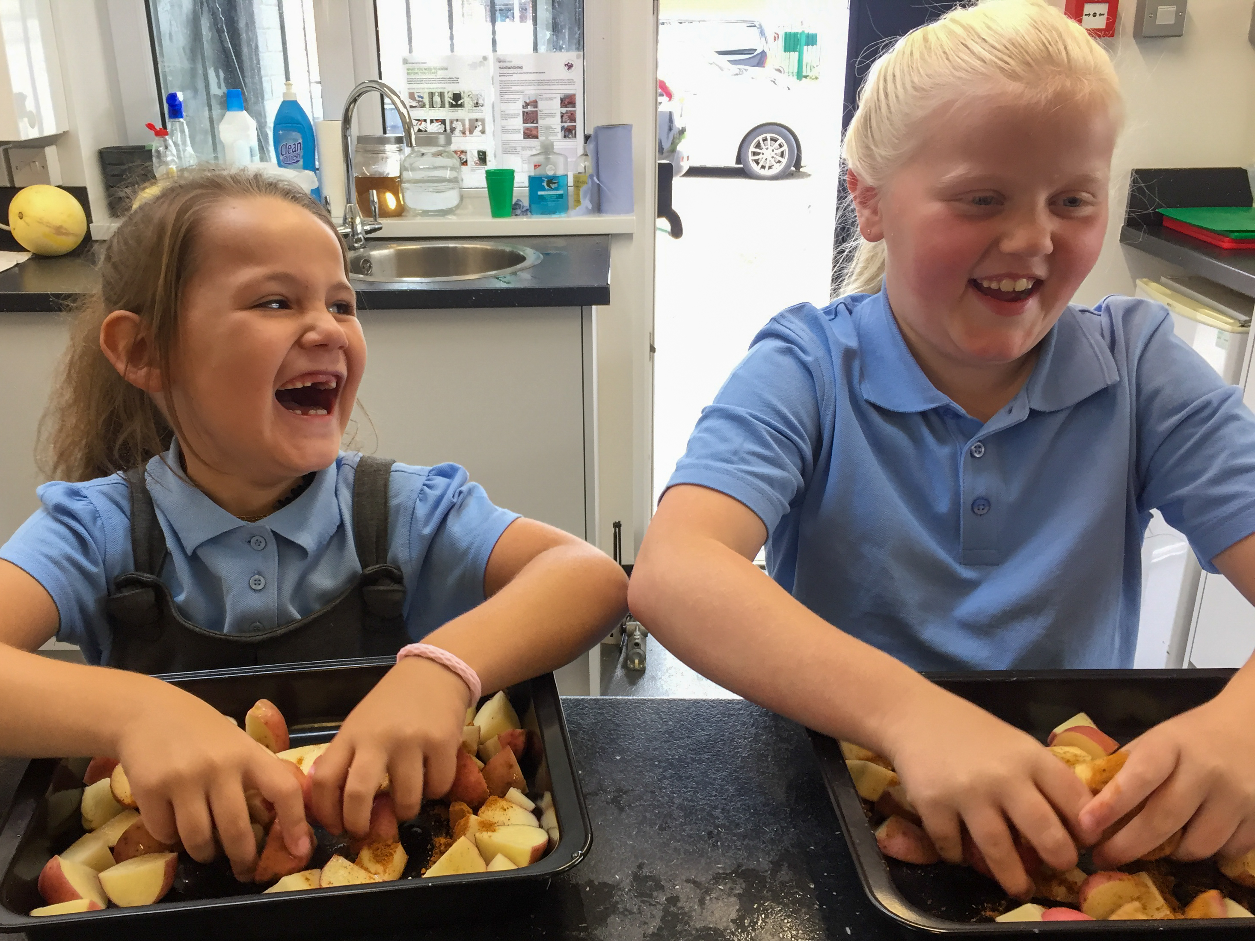
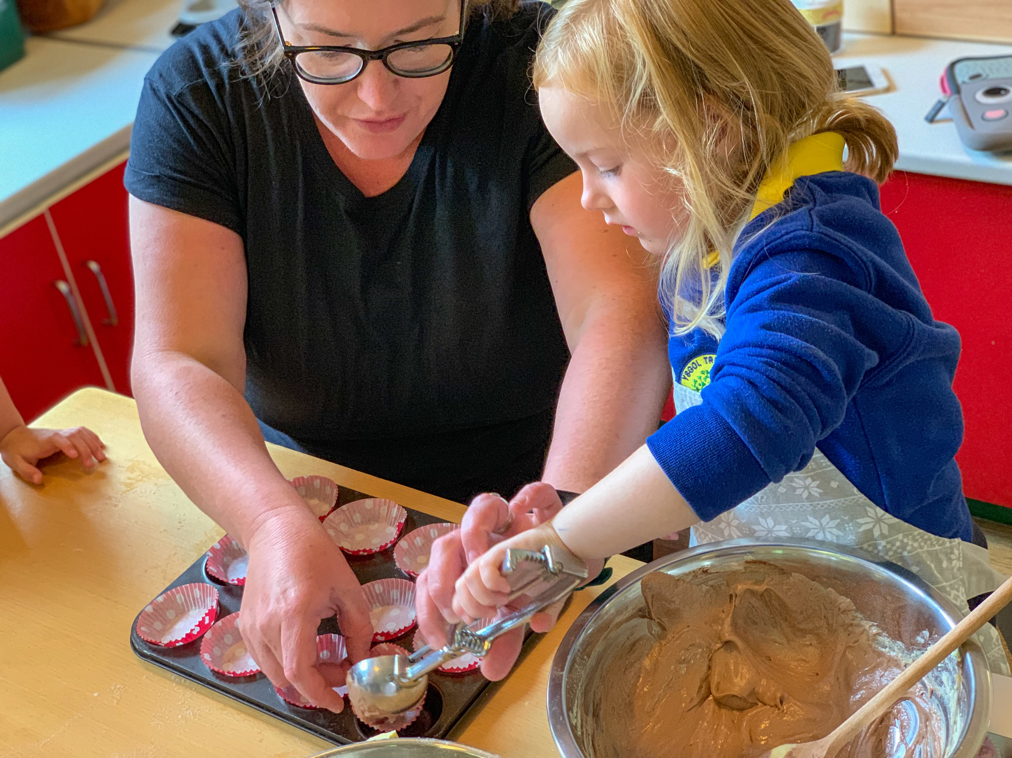
Cadoxton Curriculum: The cadoxton way!
Enrichment
To ensure that our children have every opportunity to try new experiences we offer all of our children a range of curriculum enrichments. These are coordinated by Rachel Davies and outside providers are used. Each half term is designed to offer something new and enhance our already rich curriculum offer. Experiences include; art gardening, junk food café, forces fitness, multisport, modern languages, art, woodwork, music, digital, dance, drama and yoga. We also take groups of children off site to work with students at Cardiff Met and Atlantic college. Our highly skilled LSA’s run their own enrichment activities playing to their expertise during PPA afternoons on a Weds PM
Planning, preparation and assessment (PPA)
During Wednesday afternoons teachers have time and space together to plan and assess learning. This time also enables for all teachers to have quality professional learning and training that they need to develop an innovative, exciting curriculum. Professional learning is organised for teachers in line with the SDP and also tailor made to meet the needs identified by teachers. Teachers evidence their development in their own journals and this is shared with their line managers throughout the year.

Slide 23
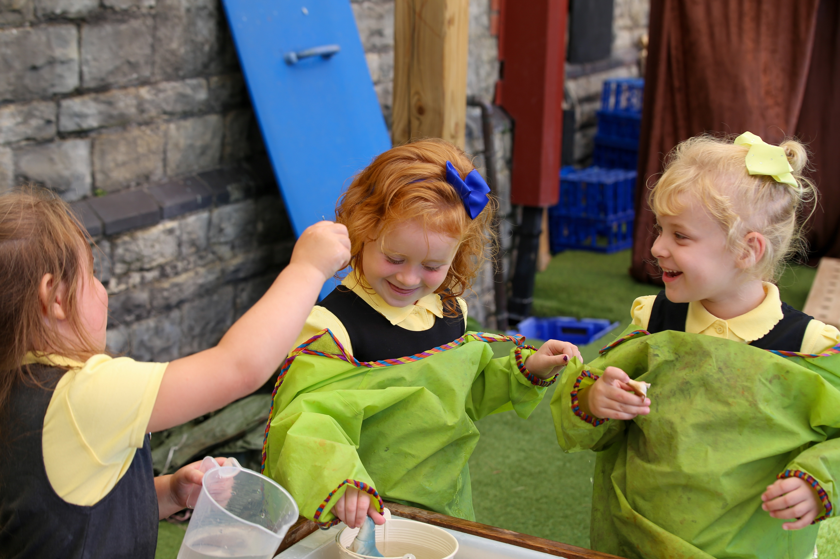
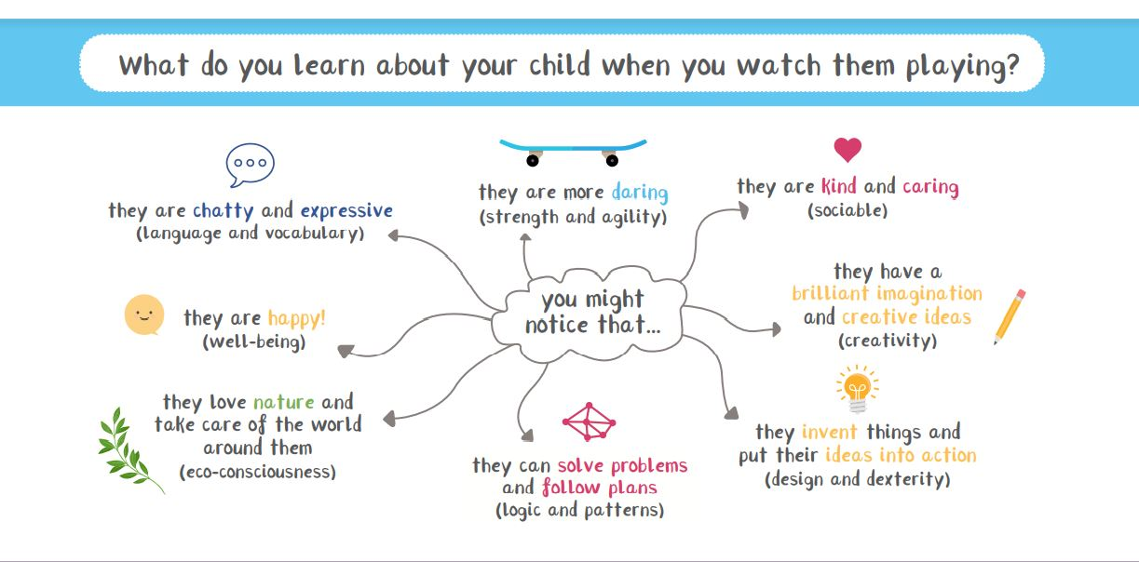
Religious VALUES EDUCATION (RVE)
Religious Education will be provided as part of the basic curriculum under the guidelines of the 1988 Education Reform Act and in accordance with the statutory requirements. The approach will be multicultural with a strong emphasis on Christianity. The programmes of study, attainment targets and assessment are approved locally by SACRE (Standing Advisory Council for Religious Education).
Daily collective worship in school is conducted through group whole school assemblies, class reflections and a weekly whole school celebration assemblies. Within these learning sessions topical issues and big questions are explored and feedback is collected and shared. Any parent who wishes to exercise their right under the 1988 Education Reform Act to withdraw their child from assemblies or RE lessons are asked to contact the Headteacher in writing. It is mandatory in the Curriculum for Wales, but now for all learners 3 - 16, as a part of the Humanities Area of Learning and Experience. We have our own unique approach to RVE and it is mapped out for all progression steps to cover the key religions.
COLLECTIVE WORSHIP
Children take part in daily collective worship in line with our school policy. This is planned by Lucy Dungey and reflects Christian values and explores big ideas and questions. It is highly reflective of relevant topics and current news locally and from around the globe. We meet online weekly for a celebration assembly and then once a month in the community centre altogether as a whole school community.
Learning through play
Foundation Phase practice places great emphasis on the holistic development of children and the development of skills across the curriculum building on previous learning experiences and knowledge. By providing a broad, rich and exciting curriculum using a variety of approaches, we develop children as individuals, recognising their level their personal motivators and interests. Children of all ages learn through play and this is a crucial time for developing lifelong learning skills by being curious and exploring. They learn how to observe, listen, respond and develop as individuals and learn how to collaborate with one another.
Pupil voice and CHOICE
We teach children the ‘language of learning’ that enables them to explain their thought process and explore how they learn best. We talk openly about learning, using language that is appropriate to their stage of development and make it visible in the room and to enable children to talk about their progress and know their next steps.
.

Slide 24
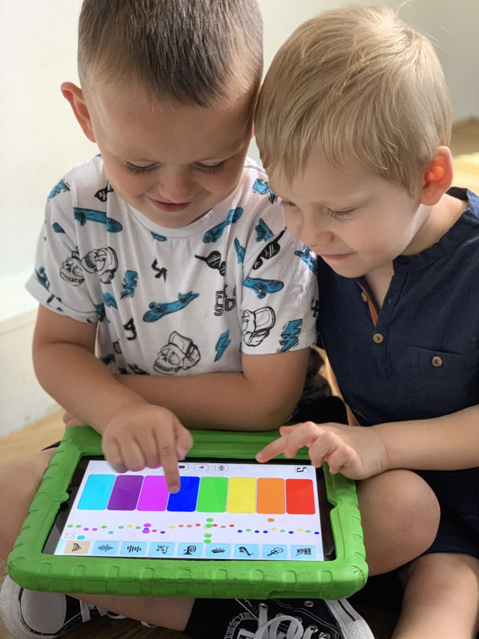
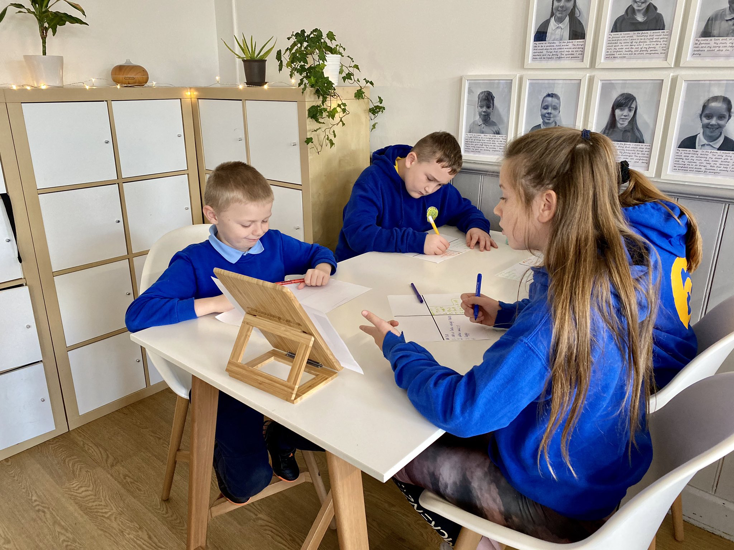
Digital learning support
We use a variety of digital programmes to support and
Enhance the basic skills in Maths and language. These include
Doodle Maths, Mathletics, Spelladrome, Active Learn. All children
from Reception to Year 6 have a HWB account and this enables
them to access online learning in a safe and secure way. They also
Have free access to windows 365 and google classrooms.
Home Learning
We believe that home learning is an opportunity for children to consolidate and refine learning that has been taught in school. We recognise that ‘home time’ is an important part of ‘family time’, and as such, homework tasks are more about developing life skills and supporting basic skills learning. The children will never be criticised for not completing it, but project work and research is encouraged and celebrated in school. We also believe that other activities such as, attending local clubs, spending time with their family and friends is vital in becoming a healthy, confident individual. It can be difficult to get the right balance between home learing, clubs and a social life. Children need time to relax and do nothing once in a while! Reading is an essential skills that children need to develop
at their own rate when they are ready. Supporting your
Child to read and enjoy books is the main focus of home
learning.
Learning environment
We see our learning environment as the third teacher
and it is set up to enable learning to be flexible, independent and based on authentic. Every space has purpose, and we believe that digital learning needs to be accessible all the time and apart of daily life. Time and space is given throughout the year to develop the indoor and outdoor learning environment and adapted to suit the needs of the learners.
Our aim is for the environment to:
Allow clear and consistent routines
Provide the space, right amount of light and consider the noise level of the space
To consider how the use of visual support can enhance learning
A stimulating environment with no clutter
Furniture is purposeful and the layout can be changed
Allow children children’s interests and lines of enquiry to be followed and allow these to be planned into the learning opportunities and enhancements you provide.
An environment where a child feels emotionally and physically safe
Promotes real life contexts for learning that are meaningful.

Slide 25
Outdoor learning
Our approach to outdoor learning is for children to experience practical activities and challenges that are with real life things! It is seen as not an extension of the classroom but as a purposeful learning environment that has a different purpose and intention. Opportunities are built into the curriculum for the children to continue their learning beyond the remit of the classroom including fieldwork in the park and Inquiry based learning in the local community. We have close links with our park and local businesses.
Relationship policy
Our philosophical approach to Relationships is at the heart of our school community. We are committed to implementing and embedding a policy that will lead to sustainable change. Healthy relationships are all about how we interact and interrelate with others and how we can create positivity with those relationships so that we can learn and grow together and be our best version of ourselves forever. The vision is for us all to embody the Four Purposes with confidence and self-belief, but this will only come if we practice healthy behaviours everyday. We will commit to building and teaching healthy relationships using an enquiry approach:
Optimising personal strengths and autonomy
Building self-esteem and confidence
Owning our emotions
Growing Resilience and grit ‘bounce back ability’
Creating a healthy lifestyle embodying hand, heart and mind.
All stakeholders engage in a cycle of continuous professional learning and use relevant research to develop a greater understanding of human relationships and the need to be tolerant, kind and respectful of one another. We will develop bespoke strategies that we will make our own, including:
Restorative Practices - Respect, Responsibility, Repair, Re-integration
Coaching and Mentoring
Common healthy language
Reflective practice - time and space
ACE informed approaches - managing trauma
We will not have a one style fits all approach but will commit to knowing what our children and families need to allow them to flourish.
Rights respecting school
At Cadoxton we believe all children need to know their rights and know the power of having a voice. We create a safe and inspiring place to learn, where children are respected, their talents are nurtured and they are able to thrive whatever their circumstances or background. Our Rights Respecting Schools Award shows that these values are embedded in daily school-life and we give children the best chance to lead happy, healthy lives and to be responsible, active citizens.
.

Slide 26
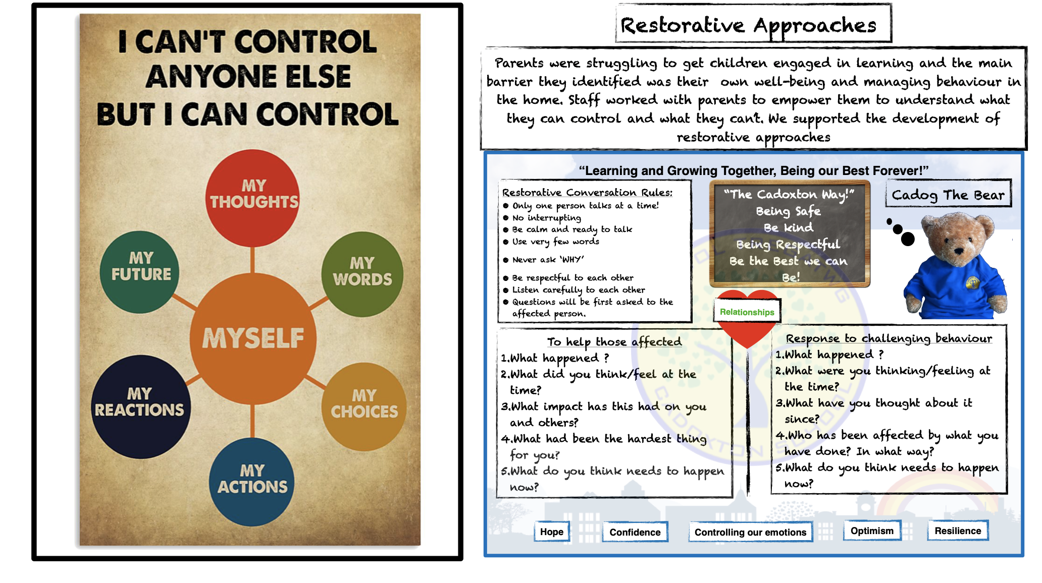
Restorative Practices
At Cadoxton we believe in using restorative practices to allow children to solve disagreements and to make the right choices this is facilitated by using a consistent set of questions. We are aware of and are very responsive to children’s emotions and understand their motivations. Learners feel that their needs are ‘known’ by their teachers, and a positive and reflective learning environment helps learners to understand the positive impact that they might have on the learning.
.
Sex and relationships
The school’s programme of sex and relationships education as agreed by the Governing Body is linked with areas of Foundation Phase curriculum and Curriculum 2008. The main emphasis is on relationships and will reflect the needs of pupils as they develop over the progression phases. We have a continuum of development that has been created in consultation with children, parents and teachers. We offer puberty talks in Year 5 and 6 giving pupils the chance to discuss sensitive issues in an informal setting. Parents will be notified when this is to take place but will not have the right to withdraw their child on request as it is part of our curriculum.

Slide 27
Reporting to parents
Teachers meet with parents either in person or virtually using zoom three times a year. At the start of the year as a class group to form new relationships and share information for the up coming year. They then meet individually in November and in July with the class teacher to discuss wellbeing, progress and academic and social targets. This process happens with the child present where appropriate in years 3-6. Annual reports are given to parents at the end of the summer term and the final progress meeting is held.
Assessment, recording and reporting
All children starting in Nursery and Reception participate in a baseline assessment. All children who join the school will participate in an on entry assessment. Teacher assessment is undertaken throughout the year and at the end of Year 2 and Year 6, results are reported nationally.
The purposes of our assessment procedures are to:
● Assist pupils to know where they are in terms of strengths and areas for development
and what action needs to be taken to further progress.
● Inform teachers, parents and governors of pupils’ progress including pupil self-
assessment and peer assessment.
A range of assessment techniques are employed which we value as a tool for learning. Detailed records are kept so that as a school we can measure and monitor our effectiveness.
Learning Reviews provide an opportunity for the children to discuss progress with their class teacher prior to consultation with parents. This puts the ownership on the learner and makes learning progress a shared process between all those involved.
These are offered during the Autumn and Spring terms with an annual report being sent out once a year. Parents are encouraged to meet the teacher if there are any ongoing concerns between these times.
Ongoing assessment and monitoring is carried out across the school including learning walks by staff, children, parents, governors and visitors to ensure that standards remain high and in line with current policy. We place a great store on learning from change and our mistakes, encouraging a resilience and positive attitude to meet challenges and to provide innovation.
Ongoing detailed assessment is carried out across the school. This is by using our school system building blocks. Some of this is formal to meet the requirements of statutory assessments such as Early years profile compact and full, and end of phase assessments. We also carry out end of FP and KS2 moderation as a authority and this is regulated. Lots of informal day to day basis teacher assessment and observations are carried out using a range of assessment materials including Building Blocks to inform ongoing short, medium and long term planning and practice.
.

Slide 28
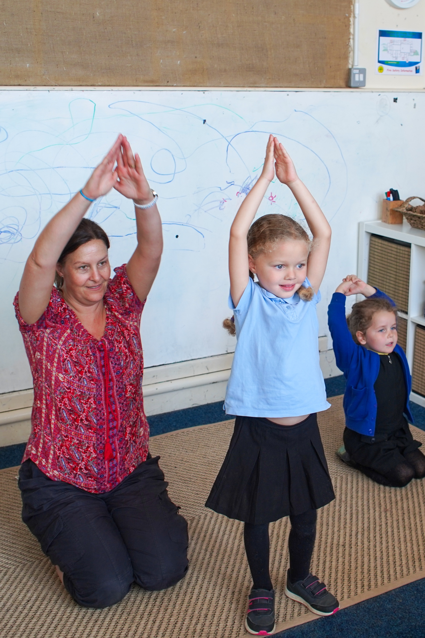
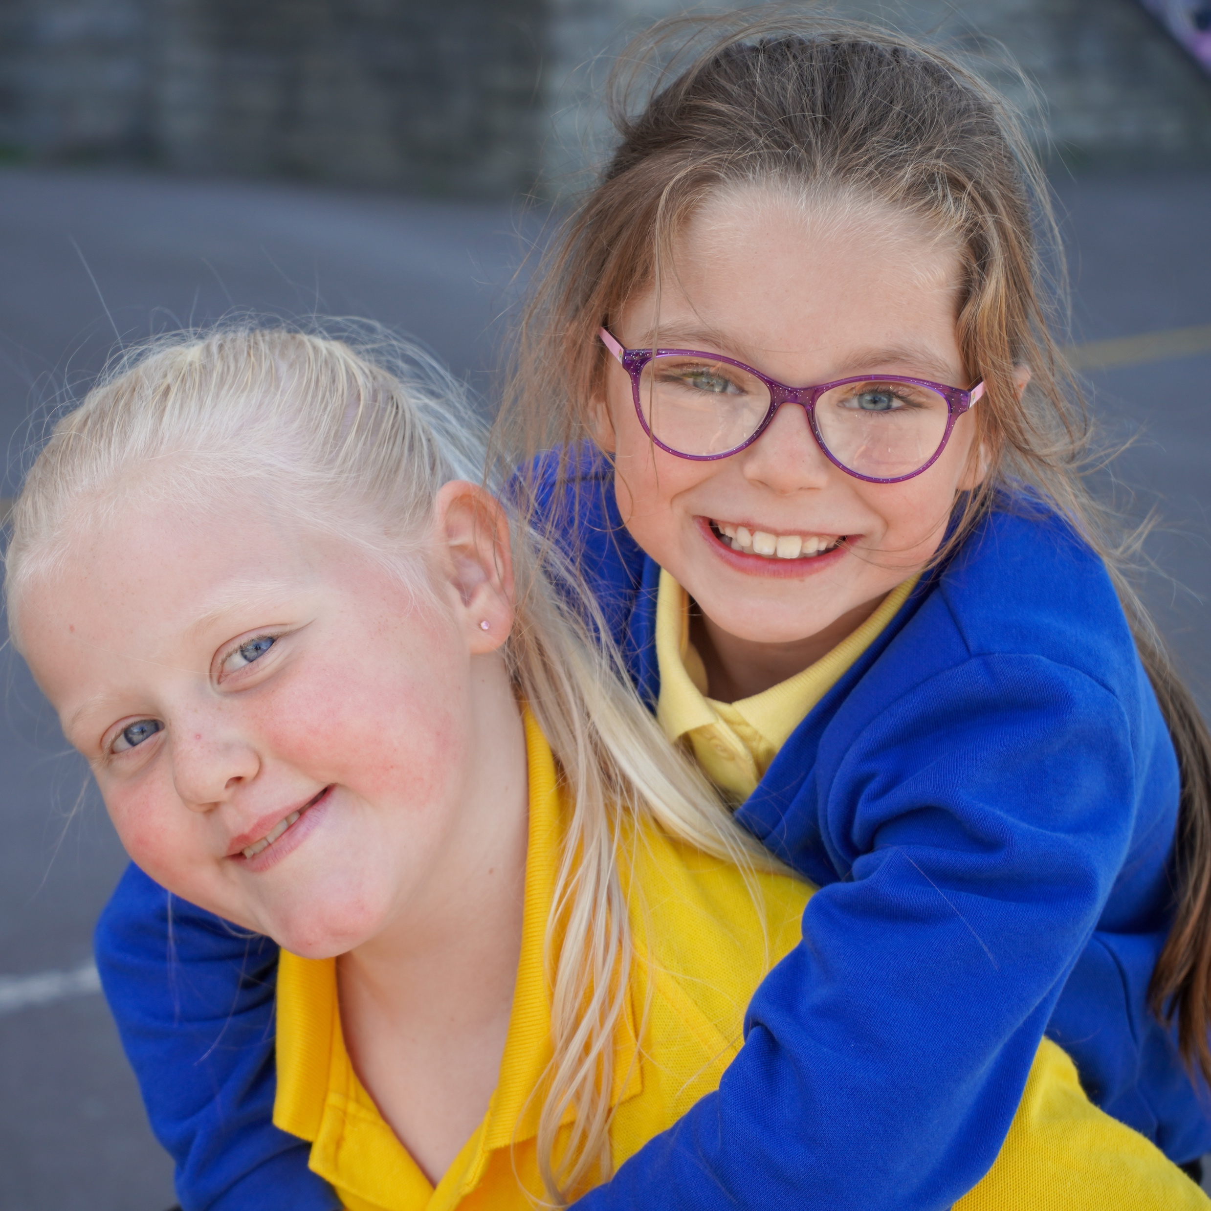
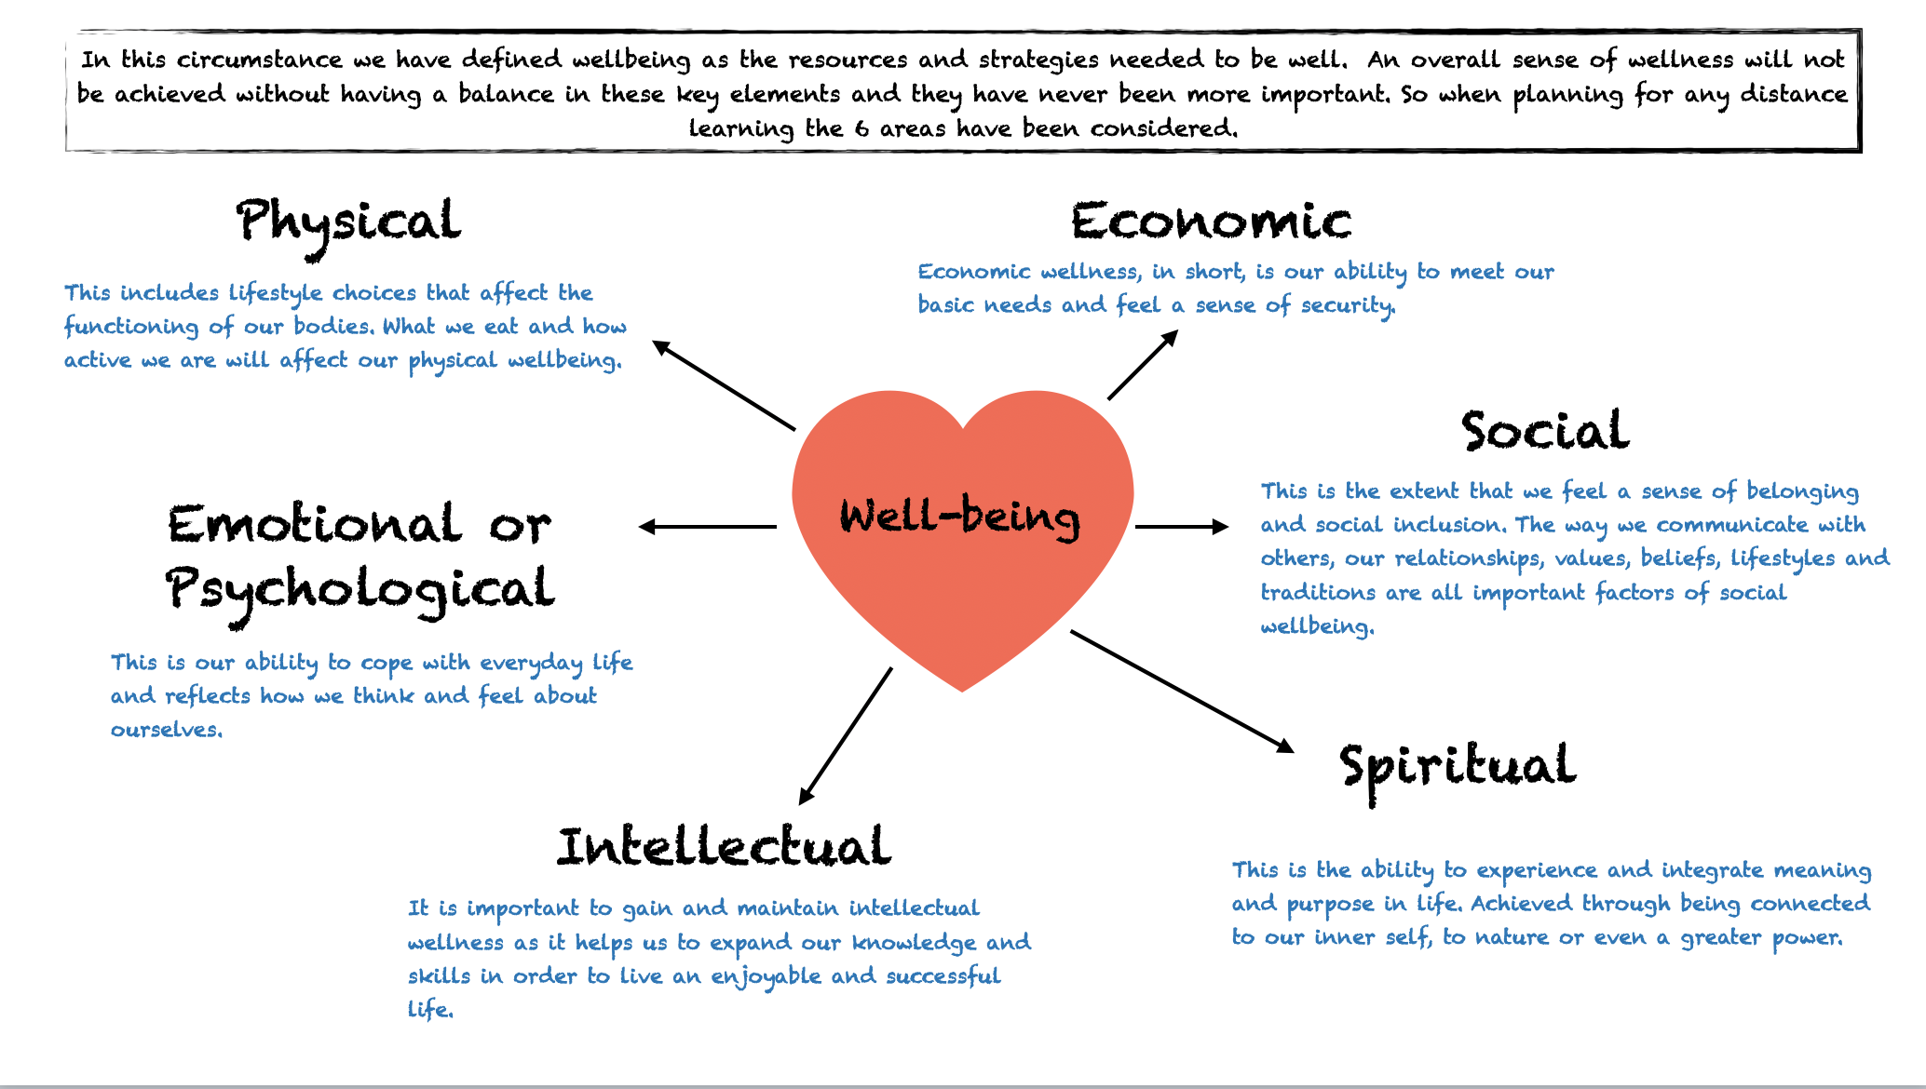
Wellbeing: The cadoxton way!
The wellbeing of all children, staff and our community is at the heart of all we do everyday. Relationships come ahead of everything else to ensure that our children are safe, healthy, happy and ready to learn. We teach positive wellbeing and support the development of strategies to maintain it.
As a school, wellbeing is an inclusive part of daily life and we encourage children to believe in themselves, be confidence, embrace new challenges and feel secure enough to take risks.
We value all children as individuals and therefore offer a bespoke curriculum that caters for all of their needs including those of the wider community. We create an ethos where all children, staff and parents show high levels of respect, care and kindness for one another and encourage our whole school community to be ethically informed citizens.
Children are encouraged to continually express their views and opinions, which provides them with a real sense of belonging. Pupil Voice is embedded in all aspects of school life and it influences the strategic direction of our school.
Some of our children and their families may face difficulties which impact on their wellbeing. As a school, we have a whole team of trained staff who work with parents and families to support the whole family unit by noticing, listening, caring and offering guidance help and support. Our community centre is a safe place for our parents to go for this support and is there to serve the needs of our community. We believe in equity for all and at the core of this is enabling our families to have a sense of belonging, regardless of their background or circumstances. By celebrating the uniqueness of every child we work hard to find what motivates our children to succeed and encourage every child to have an active voice.
Connect - Talk and listen to others and always live in the moment.
Be Active - Do what you can and enjoy what you do.
Take Notice - Remember the simple things that give you joy.
Keep Learning - Embrace new experiences and seek new opportunities.
Give - Give people your time, your words and your presence.

Slide 29
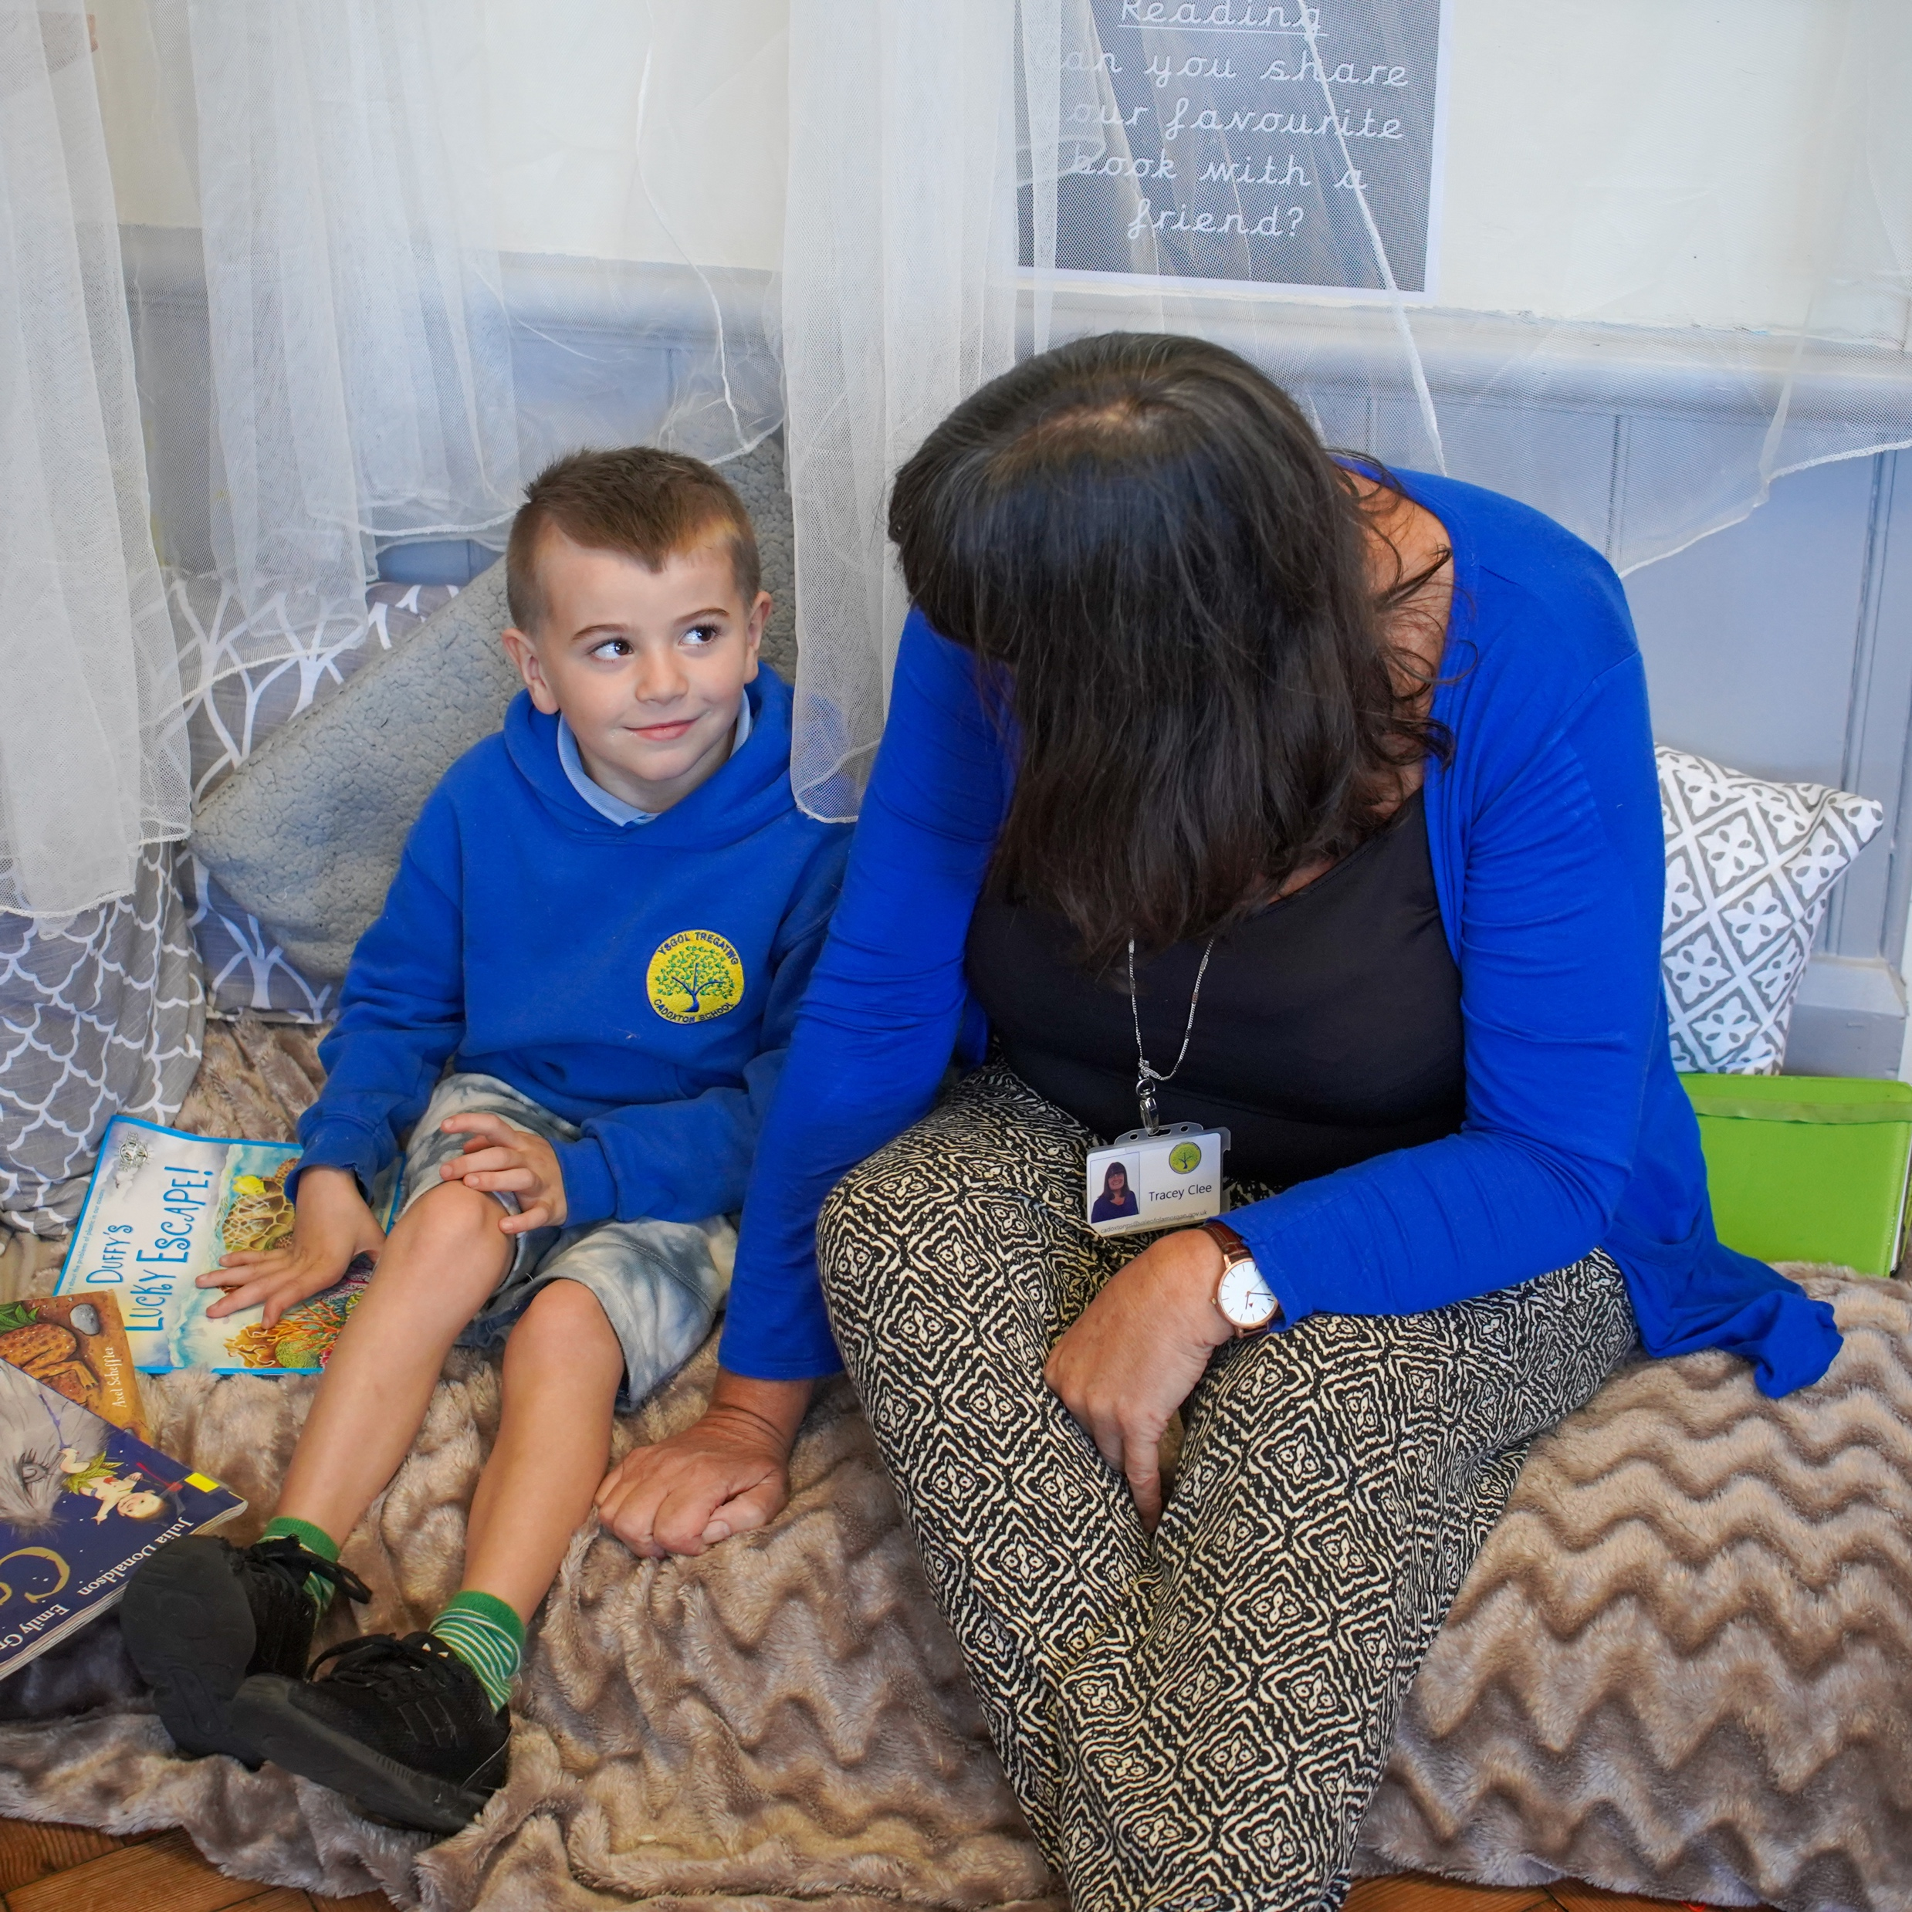
Medical
In school we have a place called our school ‘Cwtch’ This is a place where the children can go to ensure all their wellbeing needs are being met. It is also a place where a qualified first aider can administer medication and take care of any bumps and bruises. If your child does need to take medicine then you will need to fill in a form in the Cwtch located just inside the school main reception.
If your child is asthmatic, you will need to complete a form so that we know when they need their treatment. An inhaler must be provided with the prescription label clearly visible. The inhaler will be kept in the child’s classroom or centrally in the cwtch depending on the need. Children will be supervised during their use but staff will not administer inhalers.
Accidents
Every effort is made to keep all our children and staff safe. If an accident does occur, we have members of staff who are qualified in First Aid across the school. If your child needs treatment other than which we can provide at school, we will notify you immediately. It is therefore essential that emergency contact numbers are kept up to date. If the child’s accident results in further treatment then an accident form is completed and submitted to the Vale.
Personal belongings
Children are strongly advised not to bring valuables into school. We cannot take responsibility for any items that are lost, damaged or stolen. If your child is in year 5 or 6 and they need their mobile phone then they need to leave and pick it up from our school office where it will be taken care of during school hours.

Slide 30
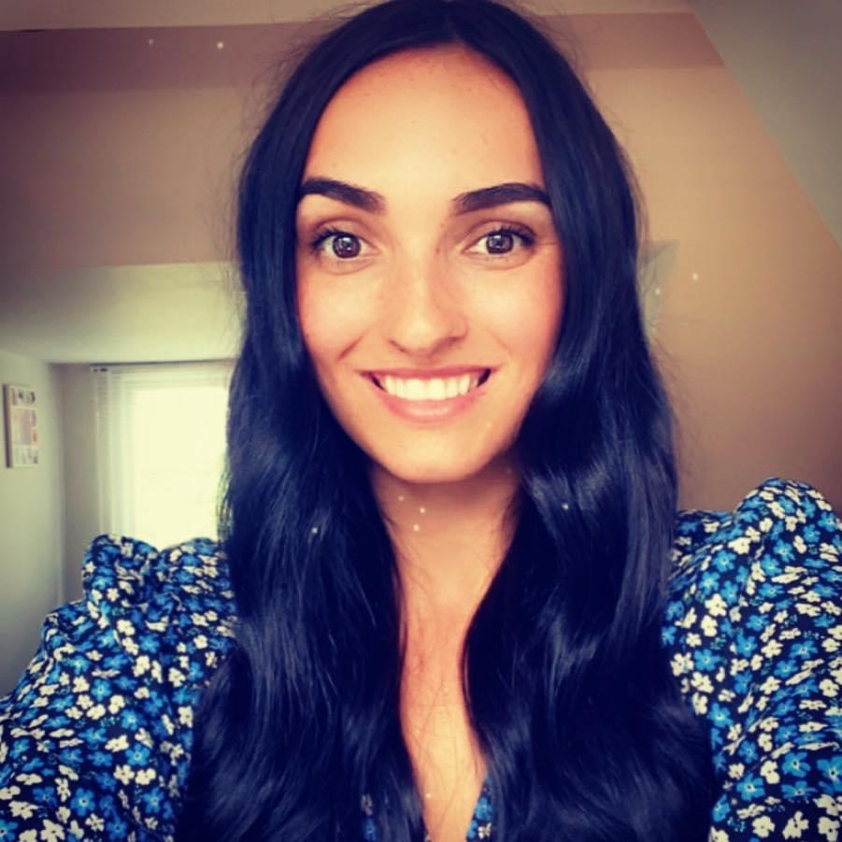
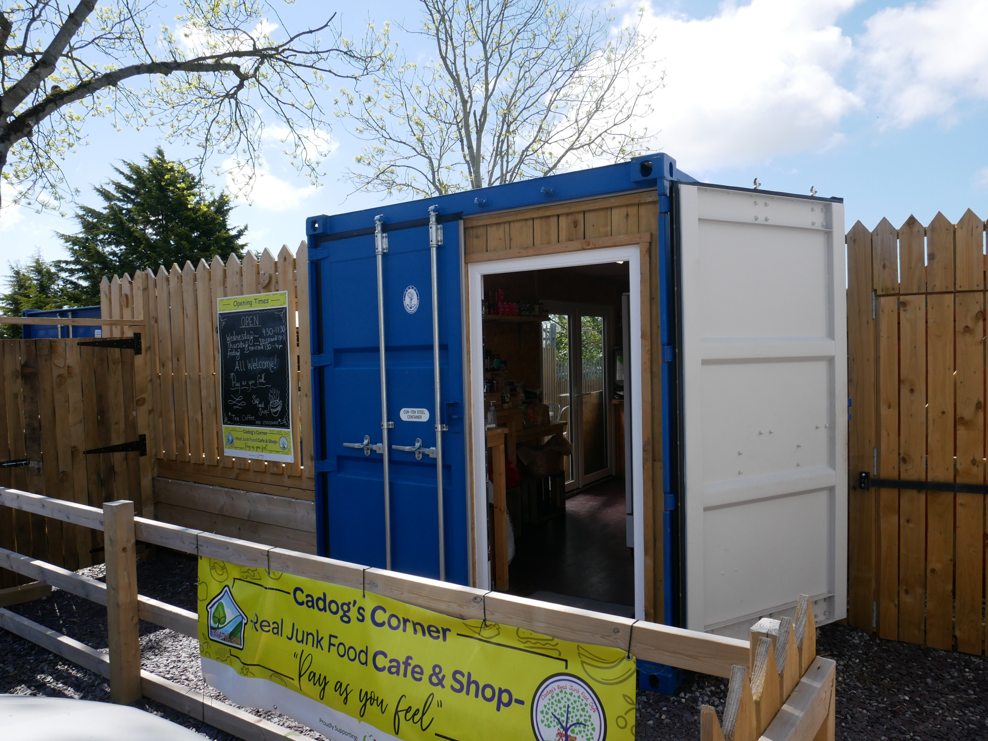
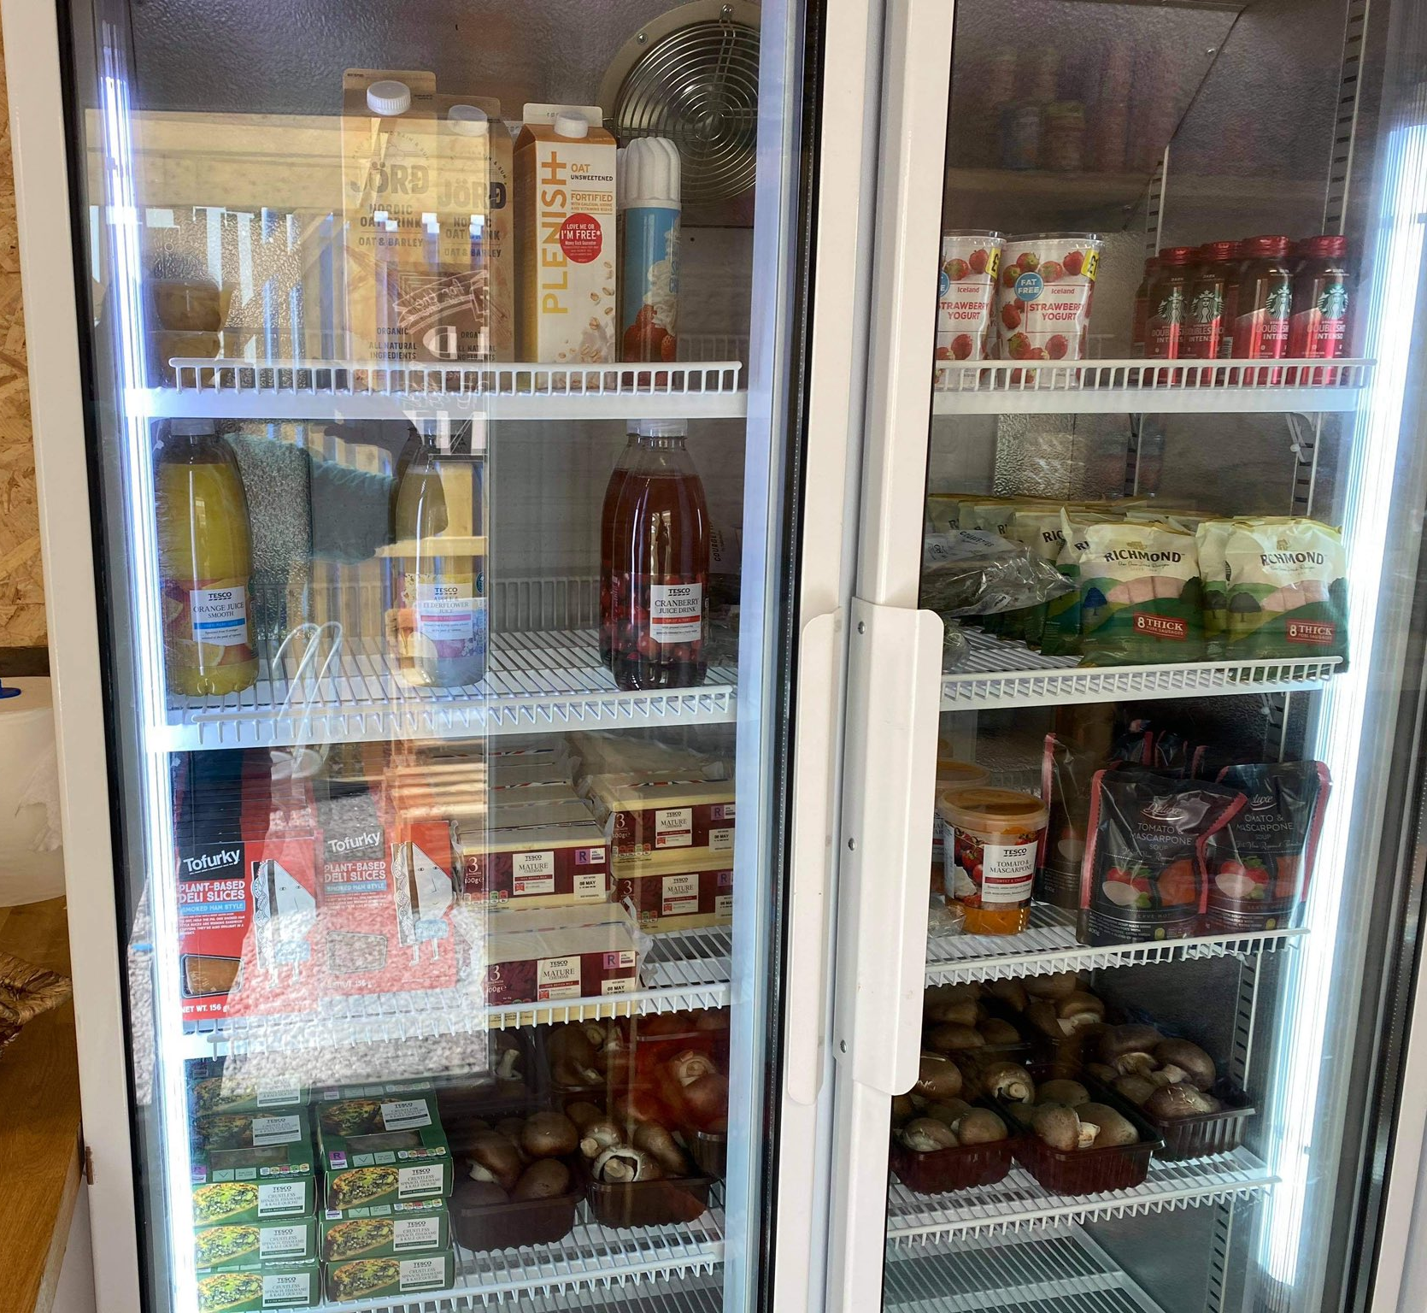
Cadog’s Corner
We are a charity that creates and sustains opportunities for the community to develop and grow stronger. Our activities are designed to address social isolation, health and wellbeing and employability with the aim to improve the lives of people living in Cadoxton, Barry. We have run a variety of different projects opening up to a breadth of different individuals within the community.
.
Hannah
Cogbill
Lead of Community Engagement
Cadog’s Café and Pay as you can shop
Cadog’s Shop is situated next to the community centre and is accessible by ALL! It is a shop where you can buy food (fresh, fridge and tinned) and essential items at a ‘pay as you can’ price. The money raised in the shop goes towards community projects. (See shop opening times)
.
Volunteers
We are looking for volunteers to help support the running of our Cadog’s Café and Shop. We are open Wednesday to Friday. You would receive time credits and have the opportunity to sign up to funded courses to further develop you!
Contact Miss Cogbill if you are interested in supporting us – CogbillH2@hwbcymru.net
.
Cadfield Van
The Cadfield Van visits 5 locations within the Cadoxton and Oakfield area every Saturday from 9-12 (specific stops). Pay £4 to visit the van and fill up your tote bag. Book your slot using Parent Pay or call the school if you do not have access to Parent Pay.

Slide 31
Community Centre
Victoria Park Community Centre is at the heart of our Cadoxton family.
Facilities – Outdoor Kitchen, Indoor Kitchen, Main Hall, Annexe, Garden Area
Parent Learning Opportunities
ADD PARENT LEARNING HERE
Coffee drop in etc.
Parent sessions etc.
What’s on?
Monday | 5:00-9:00 Tae Kwon Do 6:30-9:00 WI (3rd week of each Month)
Tuesday | 7:00-9:00 Bingo
Wednesday | 5:00-9:00 Tae Kwon Do
Thursday | 5:00-9:00 Bingo
Friday | 5:00-8:30 School of Dance
Saturday | 10:00-3:30 School of Dance
Sunday | 10:00-2:00 – Tae Kwon Do 4:30-9:00 Bingo
Private Hire
Cost - £15/hr to hire. Contact our bookings officer Janet Clarke – janclarke120@hotmail.com
Upcoming events are shared in our weekly newsletter and on Seesaw.

Slide 32
Information and Dates for the Diary
Term | Start | Half Term Start | Half Term Ends | Term Ends
Autumn 2022 | 5th September | 31st October | 4th November | 23rd December
Spring 2023 | 9th January | 20th February | 24th February | 31st March
Summer 2023 | 17th April | 29th May | 2nd June | 24th July
Inset Days 2022-2023
5th September
26th September
28th October (Cluster)
23rd December
10th March
26th May

